Slide 1
NAME: SAHIL PANDEY COHORT:ELON MUSK ROLL NO: 150096724024

Slide 2
COLOR CODE

Slide 3
COLOUR CODE:
Definition:
Colour codes are systematic representations of colors using numerical or alphanumeric values. They allow for precise communication of color choices across different platforms and mediums.
Purpose:
Colour codes help designers, artists, and manufacturers ensure that the colors they choose appear consistently, regardless of the device or material used.
Importance:
Consistency is crucial in branding and design. Color codes prevent discrepancies that can occur due to variations in monitors, printers, or materials, ensuring that the intended color is reproduced accurately.

Slide 4
Types of Colour Codes:
Hexadecimal (Hex):
Format: #RRGGBB, where RR, GG, and BB are two-digit hexadecimal numbers representing red, green, and blue components, respectively.
Example: #FF5733 represents a bright orange-red.
Usage: Primarily used in web design and CSS (Cascading Style Sheets) to specify colors for backgrounds, text, and other elements.
RGB (Red, Green, Blue):
Format: (R, G, B), where each component is an integer ranging from 0 to 255.
Example: (255, 87, 51) corresponds to the same bright orange-red as the hex code above.
Usage: Commonly used in digital displays, including computer monitors and televisions, where colours are created by combining different intensities of red, green, and blue light.
CMYK (Cyan, Magenta, Yellow, Key/Black):
Format: (C, M, Y, K), where each component represents a percentage (0-100) of the respective ink used in printing.
Example: (0, 100, 80, 0) produces a vivid red in print.
Usage: Essential in colour printing, as it reflects how colours are mixed using inks on paper, allowing for a broader colour range than RGB.

Slide 5
Colour Code Applications
Web Design:
Designers use hex and RGB codes to create visually cohesive websites. These codes ensure that the colours used in the design remain consistent across different devices and browsers.
Graphic Design:
In graphic design, CMYK codes are crucial for preparing files for print. Designers must convert RGB colours to CMYK to ensure that the printed output matches the digital design as closely as possible.
Safety and Industry:
Colour codes are vital in safety standards and regulations. For example, electrical wiring uses specific colour codes to indicate different voltage levels, and chemical labelling employs colour codes to signify hazards and safety measures.

Slide 6
Colour Psychology and Branding
Colour Meaning:
Colours evoke emotions and associations that can influence perceptions and behaviours. For instance:
Blue: Often associated with trust, calmness, and professionalism. Commonly used by financial institutions.
Red: Evokes feelings of passion, energy, and urgency. Frequently used in sales and food industries to stimulate appetite.
Green: Represents growth, health, and tranquility. Popular in environmental and wellness brands.
Branding:
Companies strategically choose colour codes to create a recognizable brand identity. For example:
Coca-Cola uses a vibrant red to evoke excitement and energy.
Facebook utilizes blue to convey trust and reliability.
Consistent use of colour codes in branding helps consumers easily identify and connect with a brand.

Slide 7
Conclusion
Recap:
Colour codes are essential tools for ensuring consistency and accuracy in design, branding, and communication across various fields.
Future Trends:
The use of colour codes is expanding with advancements in technology. For instance, augmented reality (AR) and virtual reality (VR) applications rely on precise colour representation to create immersive experiences. Additionally, artificial intelligence (AI) tools are being developed to assist in color selection and matching.
Final Thought:
A solid understanding of colour codes and their applications can enhance creativity and effectiveness in design and communication, making it a valuable skill in today's visually driven world.

Slide 8
DIFFERENCE BETWEEN GRAPHS AND CHARTS

Slide 9
Introduction to Charts and Graphs
Definition:
Charts: Visual representations that organize and summarize data in a way that is easy to understand. They can include various elements like titles, legends, and labels to provide context.
Graphs: A specific type of chart that plots numerical data along two axes (typically X and Y axes), allowing for the visualization of relationships between variables.
Purpose:
Both charts and graphs serve to simplify complex datasets, making it easier for audiences to grasp trends, patterns, and insights quickly. They are crucial tools in data analysis, reporting, and decision-making.

Slide 10
Types of Charts
Pie Charts:
Description: Circular charts divided into slices to illustrate numerical proportions. Each slice represents a category's contribution to the whole.
Usage: Best for showing relative sizes of parts to a whole, such as market share or budget distribution.
Bar Charts:
Description: Use rectangular bars to represent data quantities for different categories. The length of each bar correlates with the value it represents.
Usage: Ideal for comparing quantities across different groups, such as sales by region or survey results by demographic.
Line Charts:
Description: Connect individual data points with lines to show trends over time or continuous data.
Usage: Commonly used to visualize changes over time, such as stock prices, temperature variations, or sales growth.
Visual Appeal: Charts are often colourful and visually engaging, making them effective for presentations and reports aimed at a general audience

Slide 11
Types of Graphs
Scatter Plots:
Description: Display individual data points on a two-dimensional plane to show the relationship between two numerical variables.
Usage: Useful for identifying correlations, trends, or patterns, such as the relationship between advertising spend and sales revenue.
Line Graphs:
Description: Similar to line charts, they plot data points and connect them with lines, but they often focus on showing the relationship between two continuous variables.
Usage: Effective for visualizing trends over time in two variables, such as comparing temperature and ice cream sales over the summer.
Histograms:
Description: A type of bar graph that represents the distribution of numerical data by showing the frequency of data points within specified ranges (bins).
Usage: Ideal for understanding the distribution of data, such as test scores or age demographics.
Analytical Focus: Graphs are often used in scientific research and statistical analysis, where understanding relationships and trends in numerical data is essential

Slide 12
Key Differences
Data representation:
Charts:
Typically represent categorical data, which can be nominal (e.g., types of fruits) or ordinal (e.g., rankings). They provide a clear comparison of different categories.
Graphs:
Primarily focus on numerical data and the relationships between variables. They allow for the visualization of trends, correlations, and distributions, making them suitable for more complex data analysis.
Complexity:
Charts:
Generally simpler and more visually engaging, making them suitable for presentations and reports aimed at a broad audience. They often convey a single message or comparison.
Graphs:
Can convey more complex information and relationships between multiple variables. They may require a deeper understanding of data interpretation, making them more suitable for analytical reports and academic presentations.

Slide 13
When to Use Each
When to Use Charts:
Summarizing Data: Ideal for summarizing and comparing categorical data, making it easier for audiences to understand key takeaways.
Visual Appeal: Best for presentations where visual clarity and engagement are essential. Charts can effectively capture attention and communicate messages quickly.
Examples: Business presentations, marketing reports, and infographics.
When to Use Graphs:
Analyzing Relationships: Suitable for analyzing relationships between numerical variables, allowing for a deeper understanding of trends and correlations.
Scientific and Technical Reports: Best for scientific reports, data analysis, and situations where precise data interpretation is required. Graphs can help illustrate complex relationships and data distributions.
Examples: Research papers, statistical analyses, and financial reports

Slide 14
MICROSOFT SUITE

Slide 15
Introduction to Microsoft Office Suite
Overview:
Microsoft Office Suite is a comprehensive collection of productivity applications developed by Microsoft, designed to enhance personal and professional productivity.
Purpose:
Aims to provide users with essential tools for various tasks including document creation, data analysis, presentations, and communication.
History:
First launched in 1989, the suite has evolved significantly, integrating cloud features and collaboration tools with the introduction of Office 365.

Slide 16
Components of Microsoft Office Suite
Key Applications:
Microsoft Word: Word processing application for creating, editing, and formatting text documents.
Microsoft Excel: Spreadsheet application for data analysis, calculations, and visualization through charts.
Microsoft PowerPoint: Presentation software for creating slideshows with text, images, and multimedia.
Microsoft Outlook: Email client with calendar, task management, and contact features.
Microsoft Access: Database management system for creating and managing databases.
Microsoft OneNote: Note-taking application for gathering and organizing notes and multimedia.
Microsoft Publisher: Desktop publishing application for designing brochures, newsletters, and other printed materials.

Slide 17
Microsoft Word
Features:
Text Formatting: Rich formatting options including fonts, sizes, colors, and styles (bold, italics, underline).
Templates: A variety of pre-designed templates for resumes, letters, reports, and more.
Collaboration Tools: Real-time co-authoring, comments, and track changes for collaborative editing.
Advanced Editing Tools: Spell check, grammar check, and readability statistics.
Use Cases: Ideal for creating reports, letters, essays, and any document requiring extensive text formatting.

Slide 18
Microsoft Excel
Features:
Data Analysis: Functions and formulas for calculations, statistical analysis, and data manipulation.
Charts and Graphs: Tools for visualizing data through various chart types (bar, line, pie, etc.).
PivotTables: Advanced data summarization tool for analyzing large datasets.
Data Import/Export: Ability to import data from various sources and export to different formats (CSV, PDF).
Use Cases: Commonly used for financial analysis, budgeting, inventory tracking, and any task involving numerical data.

Slide 19
Microsoft PowerPoint
Features:
Slide Design: A variety of templates and design tools for creating visually appealing presentations.
Animations and Transitions: Options for adding animations to text and images, as well as transitions between slides.
Multimedia Integration: Ability to embed videos, audio, and images from various sources.
Presenter Tools: Features like Presenter View for managing slides and notes during presentations.
Use Cases: Commonly used for business presentations, educational lectures, and public speaking engagements.

Slide 20
Microsoft Outlook
Features:
Email Management: Comprehensive email client with features for organizing, filtering, and searching emails.
Calendar: Integrated calendar for scheduling appointments, meetings, and events.
Task Management: Tools for creating and tracking tasks and to-do lists.
Contacts: Centralized contact management for storing and organizing contact information.
Use Cases: Essential for professional communication, scheduling, and task management in business environments.

Slide 21
Microsoft Access
Features:
Database Creation: Tools for creating and managing relational databases.
Queries: Ability to run complex queries to extract and analyze data from databases.
Forms and Reports: Design forms for data entry and generate reports for data analysis.
Integration: Can integrate with other Office applications for data sharing and reporting.
Use Cases: Suitable for businesses needing to manage large volumes of data, such as customer databases, inventory systems, and sales tracking.

Slide 22
Microsoft OneNote
Features:
Note Organization: Create notebooks, sections, and pages to organize notes effectively.
Multimedia Support: Ability to include images, audio recordings, and drawings in notes.
Tagging and Search: Features for tagging notes and powerful search capabilities to find information quickly.
Collaboration: Share notebooks with others for collaborative note-taking.
Use Cases: Ideal for students, researchers, and professionals for gathering and organizing information.

Slide 23
Microsoft Publisher
Features:
Desktop Publishing Tools: Provides a user-friendly interface for designing and creating professional-quality publications.
Templates and Layouts: Offers a wide range of templates for brochures, flyers, newsletters, business cards, and more, allowing users to start quickly.
Graphic Design Tools: Includes features for inserting and editing images, text boxes, and shapes, as well as aligning and grouping objects for better layout.
Print and Web Options: Allows users to create publications for both print and digital distribution, with options for exporting to PDF or HTML formats.
Use Cases: Ideal for small businesses, marketing teams, and individuals looking to create visually appealing printed materials without needing extensive graphic design skills

Slide 24
Conclusion and Benefits of Microsoft Office Suite
Integration:
All applications within the suite are designed to work seamlessly together, enabling users to easily share data and content across different programs (e.g., embedding Excel charts in Word documents).
Cloud Accessibility:
With Microsoft 365 (formerly Office 365), users can access their documents and applications from anywhere, collaborate in real-time, and utilize cloud storage through OneDrive.
User Support and Resources:
Extensive online resources, tutorials, and community forums are available to help users maximize their use of the suite.
Versatility:
Suitable for a wide range of users, including students, educators, professionals, and businesses of all sizes, making it a versatile tool for various tasks.
Final Thoughts:
Microsoft Office Suite remains a leading choice for productivity software due to its comprehensive features, ease of use, and continuous updates to meet user needs.

Slide 25
PASCL TRIANGLE

Slide 26
Introduction to Pascal's Triangle
Definition:
Pascal's Triangle is a triangular array of numbers where each number is the sum of the two directly above it.
Historical Context:
Named after the French mathematician Blaise Pascal, though it has been studied in various forms across cultures, including in ancient China and Persia.
Structure:
The triangle starts with a single "1" at the top, and each subsequent row contains one more element than the previous row.

Slide 27
Construction of Pascal's Triangle
Formation Rules:
The first row (0th row) is simply "1".
Each number in subsequent rows is calculated as the sum of the two numbers directly above it:
For example, the second row (1st row) is "1 1".
The third row (2nd row) is "1 2 1", where 2 is the sum of the two 1s from the row above.

Slide 28
Properties of Pascal's Triangle
Binomial Coefficients:
Each number in Pascal's Triangle represents a binomial coefficient, denoted as C(n, k), which represents the number of ways to choose k elements from a set of n elements.
Symmetry:
The triangle is symmetric; C(n, k) = C(n, n-k).
Sum of Rows:
The sum of the numbers in the nth row is equal to 2^n. For example, the sum of the 3rd row (1, 3, 3, 1) is 8, which is 2^3.

Slide 29
Applications of Pascal's Triangle
Combinatorics:
Used to calculate combinations and probabilities in statistics.
Algebra:
Provides coefficients for the expansion of binomials (e.g., (a + b)^n).
Fibonacci Sequence:
The Fibonacci numbers can be derived from the sums of the diagonals of Pascal's Triangle.
Probability:
Helps in calculating probabilities in various scenarios, such as games and decision-making processes.

Slide 30
Conclusion
Significance:
Pascal's Triangle is not just a mathematical curiosity; it has profound implications in various fields such as algebra, probability, and combinatorics.
Further Exploration:
Encourages exploration into related mathematical concepts such as combinatorial identities, the Fibonacci sequence, and even fractals.
Final Thoughts:
Understanding Pascal's Triangle enhances one’s appreciation of mathematical patterns and their applications in real-world problems.

Slide 31
SALESFORCE

Slide 32
Introduction to Salesforce
Overview:
Salesforce is a cloud-based customer relationship management (CRM) platform that provides businesses with tools to manage customer interactions, sales processes, and marketing campaigns.
History:
Founded in 1999 by Marc Benioff and Parker Harris, Salesforce pioneered the SaaS (Software as a Service) model, allowing companies to access software via the internet.
Mission:
To help organizations connect with their customers in a whole new way.

Slide 33
Core Features of Salesforce
Customer Relationship Management (CRM):
Centralized database for managing customer information, interactions, and history.
Sales Cloud:
Tools for managing sales processes, tracking leads, opportunities, and performance metrics.
Service Cloud:
Solutions for customer service management, including case tracking, support, and service automation.
Marketing Cloud:
Marketing automation tools for email marketing, social media engagement, and customer journey management.
Analytics Cloud:
Advanced analytics and reporting capabilities for data-driven decision-making.

Slide 34
Salesforce Architecture
Multi-Tenant Architecture:
All users share the same infrastructure and codebase, allowing for efficient resource utilization and updates.
APIs and Integrations:
Robust APIs for integrating with other applications and services, enabling seamless data flow between systems.
AppExchange:
A marketplace for third-party applications that can be integrated with Salesforce to extend functionality.

Slide 35
Salesforce Products and Solutions
Salesforce Essentials:
Designed for small businesses, providing essential CRM features.
Salesforce Lightning:
A modern user interface that enhances user experience and productivity.
Salesforce Einstein:
AI-powered analytics and insights that help businesses make smarter decisions.
Community Cloud:
A platform for creating branded communities for customers, partners, and employees to collaborate.
Field Service Lightning:
Tools for managing field service operations, including scheduling, dispatching, and mobile access.

Slide 36
Benefits of Using Salesforce
Improved Customer Relationships:
Centralized data helps businesses understand and respond to customer needs effectively.
Increased Sales Efficiency:
Automation of sales processes allows sales teams to focus on closing deals rather than administrative tasks.
Enhanced Collaboration:
Tools for collaboration among teams, leading to better communication and teamwork.
Scalability:
Easily scalable to accommodate business growth and changing needs.
Real-Time Data Access:
Cloud-based access to data from anywhere, enabling informed decision-making on the go.

Slide 37
Salesforce Implementation Process
Planning:
Define goals, objectives, and scope of the implementation.
Customization:
Tailor Salesforce to meet specific business needs through custom fields, objects, and workflows.
Data Migration:
Transfer existing customer data into Salesforce, ensuring data quality and integrity.
Training:
Provide training for users to ensure they are comfortable using the platform.
Go-Live and Support:
Launch the system and provide ongoing support and maintenance.

Slide 38
Salesforce Ecosystem
Trailhead:
Salesforce’s online learning platform offering courses and certifications to enhance user skills and knowledge.
Community:
A vibrant community of users, developers, and partners who share best practices, solutions, and resources.
Partner Network:
A network of consulting and technology partners that offer specialized services and solution

Slide 39
Use Cases of Salesforce
Sales Management:
Track leads, manage customer accounts, and analyze sales performance.
Customer Support:
Manage customer inquiries and support tickets, enhancing customer satisfaction.
Marketing Campaigns:
Automate marketing efforts, segment audiences, and analyze campaign performance.
Data Analytics:
Use analytics tools to gain insights into customer behavior and business performance.

Slide 40
Challenges and Considerations
Cost:
Subscription-based pricing can be a concern for smaller businesses.
Complexity:
The platform can be complex, requiring time and resources for proper implementation and customization.
User Adoption:
Ensuring user adoption and proficiency can be challenging, necessitating ongoing training and support.
Data Security:
Businesses must ensure compliance with data protection regulations and manage data security effectively.

Slide 41
Conclusion
Significance of Salesforce:
Salesforce has transformed how businesses manage customer relationships, offering a comprehensive suite of tools that enhance sales, service, and marketing efforts.
Key Takeaways:
Robust Functionality: Salesforce provides a wide range of features that cater to various business needs, from small startups to large enterprises.
Scalability: The platform's flexibility allows businesses to scale operations seamlessly as they grow.
Data-Driven Decisions: With powerful analytics and reporting tools, organizations can make informed decisions based on real-time data insights.
Future Outlook:
As businesses continue to embrace digital transformation, Salesforce is poised to remain a leader in the CRM space, constantly innovating with AI, automation, and integration capabilities.
Call to Action:
Consider exploring Salesforce for your organization to enhance customer engagement, streamline operations, and drive growth. Leverage resources like Trailhead for training and community support to maximize your investment.

Slide 42
TYPES OF SALESFORCE

Slide 43
Sales Cloud
Description:
Sales Cloud is a comprehensive sales automation tool designed to help sales teams manage leads, opportunities, and customer accounts.
Key Features:
Lead and Opportunity Management: Track potential sales and manage customer interactions.
Sales Forecasting: Analyze sales data to predict future performance.
Mobile Access: Sales teams can access data on the go through mobile applications.
Use Case:
Ideal for organizations looking to streamline their sales processes and improve conversion rates.

Slide 44
Service Cloud
Description:
Service Cloud focuses on customer service and support, enabling businesses to provide exceptional customer experiences.
Key Features:
Case Management: Track and resolve customer issues efficiently.
Knowledge Base: Create a repository of articles and FAQs for self-service support.
Omni-Channel Support: Engage customers through various channels (phone, email, chat, social media).
Use Case:
Perfect for businesses aiming to enhance customer satisfaction and loyalty through effective support.

Slide 45
Marketing Cloud
Description:
Marketing Cloud is a powerful platform for managing marketing campaigns and customer engagement across multiple channels.
Key Features:
Email Marketing: Create and automate personalized email campaigns.
Customer Journey Mapping: Design and track customer journeys for targeted engagement.
Social Media Marketing: Manage social media interactions and campaigns.
Use Case:
Suitable for organizations looking to optimize their marketing strategies and improve customer outreach.

Slide 46
Community Cloud and Other Solutions
Description:
Community Cloud: A platform for creating branded online communities for customers, partners, and employees to collaborate and share information.
Other Salesforce Solutions:
Analytics Cloud: Advanced analytics and reporting tools for data-driven decision-making.
Field Service Lightning: Manage field service operations including scheduling and dispatching.
Einstein Analytics: AI-powered insights and predictive analytics for enhanced business intelligence.
Use Case:
Community Cloud is ideal for businesses wanting to foster collaboration and engagement among stakeholders

Slide 47
GOOGLE SHEETS

Slide 48
What is Google Sheets?
Overview:
Google Sheets is a cloud-based spreadsheet application that is part of Google Workspace (formerly G Suite). It allows users to create, edit, and collaborate on spreadsheets online.
Key Features:
Real-Time Collaboration: Multiple users can work on a sheet simultaneously, with changes visible in real-time.
Accessibility: Accessible from any device with internet connectivity, including desktops, tablets, and smartphones.
Integration with Google Workspace: Seamlessly integrates with other Google applications like Google Docs, Google Slides, and Google Forms.
Templates and Functions: Offers a variety of templates and built-in functions (e.g., SUM, AVERAGE, VLOOKUP) to facilitate data analysis and organization.

Slide 49
Benefits and Use Cases of Google Sheets
Benefits:
Cost-Effective: Free to use with a Google account, making it accessible for individuals and organizations of all sizes.
Version History: Automatically saves changes and maintains a version history, allowing users to revert to previous versions.
Data Sharing and Permissions: Users can easily share sheets with others, controlling permissions for viewing or editing.
Use Cases:
Data Analysis: Ideal for analyzing data through charts, pivot tables, and formulas.
Project Management: Used for tracking project timelines, tasks, and resources.
Budgeting and Financial Tracking: Helps individuals and businesses manage budgets and track expenses.
Surveys and Data Collection: Can be used in conjunction with Google Forms to collect and analyze survey data.

Slide 50
CHARACTERISTICS OF GOOGLE SHEETS

Slide 51
Real-Time Collaboration
Description:
Google Sheets allows multiple users to work on the same spreadsheet simultaneously.
Key Features:
Live Editing: Changes made by one user are instantly visible to all collaborators.
Commenting: Users can leave comments and suggestions, facilitating communication.
Version Control: Users can see who made changes and revert to previous versions if needed.

Slide 52
Cloud-Based Accessibility
Description:
As a cloud-based application, Google Sheets can be accessed from any device with an internet connection.
Key Features:
Cross-Device Compatibility: Available on desktops, laptops, tablets, and smartphones.
Offline Mode: Users can enable offline access to view and edit sheets without an internet connection.
Automatic Saving: Changes are saved automatically, reducing the risk of data loss.

Slide 53
Integration with Google Workspace
Description:
Google Sheets seamlessly integrates with other Google Workspace applications.
Key Features:
Data Import: Easily import data from Google Forms, Google Docs, and other sources.
Linking with Google Drive: Store and organize sheets within Google Drive for easy access and sharing.
Collaboration with Other Apps: Share data with Google Slides for presentations or Google Docs for reports.

Slide 54
Extensive Functions and Formulas
Description:
Google Sheets offers a wide range of built-in functions and formulas to perform calculations and data analysis.
Key Features:
Mathematical Functions: Basic functions like SUM, AVERAGE, and COUNT, as well as complex statistical and financial functions.
Logical Functions: Functions like IF, AND, and OR for conditional calculations.
Array Formulas: Support for array formulas to perform calculations on multiple cells at once.

Slide 55
Data Visualization and Analysis Tools
Description:
Google Sheets provides various tools for visualizing and analyzing data effectively.
Key Features:
Charts and Graphs: Create bar charts, line graphs, pie charts, and more to represent data visually.
Conditional Formatting: Highlight cells based on specific criteria to identify trends and outliers easily.
Pivot Tables: Summarize and analyze large datasets efficiently, allowing users to extract meaningful insights.

Slide 56
Add-Ons and Extensions
Description:
Google Sheets supports a wide range of add-ons and extensions to enhance functionality.
Key Features:
Marketplace Access: Users can access the Google Workspace Marketplace to find add-ons for various tasks.
Custom Functions: Add-ons can introduce new functions and capabilities tailored to specific needs.
Automation Tools: Integrate with tools like Zapier or Automate.io to automate workflows and data processing.

Slide 57
Data Validation and Protection
Description:
Google Sheets provides tools for ensuring data integrity and security.
Key Features:
Data Validation: Set rules for cell entries (e.g., dropdown lists, number ranges) to ensure correct data input.
Protected Ranges: Protect specific cells or ranges to prevent unauthorized editing.
User Permissions: Control who can view or edit the sheet, enhancing security for sensitive data.

Slide 58
Customizable Templates
Description:
Google Sheets offers a variety of customizable templates for different use cases.
Key Features:
Pre-Built Templates: Users can choose from templates for budgets, project tracking, invoices, and more.
Customization Options: Easily modify templates to fit specific needs and branding.
Template Sharing: Share customized templates with team members or the public for collaborative use.

Slide 59
Integration with Third-Party Applications
Description:
Google Sheets can be integrated with various third-party applications for enhanced functionality.
Key Features:
CRM and Marketing Tools: Integrate with platforms like Salesforce, HubSpot, or Mailchimp for streamlined data management.
Data Import/Export: Easily import data from or export to other applications, such as Microsoft Excel or CSV files.
API Access: Developers can use Google Sheets API to create custom applications and automate data workflows.

Slide 60
Use Cases in Different Industries
Description:
Google Sheets is versatile and can be utilized across various industries for different purposes.
Key Features:
Finance: Budget tracking, financial reporting, and forecasting.
Education: Grade tracking, attendance sheets, and collaborative projects.
Healthcare: Patient management, appointment scheduling, and data analysis.
Marketing: Campaign tracking, lead management, and performance analysis.

Slide 61
ADVANTAGES OF GOOGLE SHEETS

Slide 62
Cost-Effective Solution
Description:
Google Sheets is free to use with a Google account, making it accessible for individuals and businesses of all sizes.
Benefits:
No Software Purchase: Unlike traditional spreadsheet software that often requires a one-time purchase or subscription, Google Sheets is completely free.
Ideal for Startups: Startups and small businesses can leverage powerful spreadsheet capabilities without incurring costs, allowing them to allocate resources elsewhere.
Educational Use: Schools and educational institutions can use Google Sheets without licensing fees, promoting learning and collaboration among students.

Slide 63
Real-Time Collaboration
Description:
Multiple users can work on a spreadsheet simultaneously, enhancing teamwork and productivity.
Benefits:
Instant Updates: Changes made by one user are immediately visible to others, facilitating smoother collaboration.
Commenting and Tagging: Users can leave comments and tag others for feedback, ensuring clear communication within the document.
Remote Work Friendly: Supports remote teams by allowing seamless collaboration from different locations, making it easier to work together on projects.

Slide 64
Cloud-Based Accessibility
Description:
Accessible from any device with an internet connection, including computers, tablets, and smartphones.
Benefits:
Work from Anywhere: Users can access their spreadsheets from any location, whether at home, in the office, or on the go.
Cross-Device Syncing: Changes made on one device sync automatically across all devices, ensuring users always have the latest version.
No Installation Required: Users can start using Google Sheets without needing to install software, making it convenient and user-friendly.

Slide 65
Automatic Saving and Version Contro
Description:
Google Sheets automatically saves changes in real-time and maintains a version history.
Benefits:
Data Loss Prevention: Automatic saving means users do not have to worry about losing their work due to crashes or power outages.
Version History: Users can view and restore previous versions of the spreadsheet, providing peace of mind and the ability to recover from mistakes.
Audit Trail: The version history feature allows users to track changes and see who made edits, which is useful for accountability in collaborative environments.

Slide 66
Integration with Google Workspace
Description:
Seamlessly integrates with other Google applications like Docs, Slides, and Forms.
Benefits:
Streamlined Workflows: Users can easily link data from Google Forms to Sheets for real-time data collection and analysis.
Enhanced Presentations: Data visualizations created in Sheets can be directly imported into Google Slides for presentations, ensuring consistency and accuracy.
Collaborative Documents: Users can create a comprehensive project plan in Sheets and link it to a Google Doc for detailed reports, enhancing overall project management.

Slide 67
Extensive Functions and Formulas
Description:
Offers a wide range of built-in functions and formulas for calculations and data analysis.
Benefits:
Diverse Functionality: Users can perform everything from basic arithmetic to complex statistical analyses using functions like VLOOKUP, INDEX, and MATCH.
Automated Calculations: Formulas can be set up to automatically calculate totals, averages, and other metrics, reducing manual work.
Custom Functions: Users with coding skills can create custom functions using Google Apps Script to tailor calculations to specific needs.

Slide 68
Data Visualization Tools
Description:
Provides various tools for visualizing data, including charts, graphs, and conditional formatting.
Benefits:
Variety of Chart Types: Users can create line graphs, bar charts, pie charts, and more to represent data visually, making it easier to identify trends.
Conditional Formatting: This feature allows users to highlight cells based on specific criteria (e.g., sales above a certain amount), helping to quickly identify important data points.
Interactive Dashboards: Users can create dynamic dashboards that update automatically as data changes, providing real-time insights into performance metrics.

Slide 69
Add-Ons and Customization
Description:
Supports a variety of add-ons and extensions to enhance functionality.
Benefits:
Google Workspace Marketplace: Users can browse and install add-ons that extend Sheets' capabilities, such as project management tools, data analysis software, and more.
Custom Templates: Users can create or download templates for specific tasks (e.g., budgeting, invoicing) to save time and streamline processes.

Slide 70
Strong Data Security
Description:
Google Sheets provides robust security features to protect data.
Benefits:
User Permissions: Users can set specific permissions for individuals or groups, allowing them to control who can view or edit the spreadsheet. This is crucial for maintaining data confidentiality.
Two-Factor Authentication: Google accounts can be secured with two-factor authentication, adding an extra layer of protection against unauthorized access.
Data Encryption: Data is encrypted in transit and at rest, ensuring that sensitive information is secure from potential breaches.

Slide 71
Community and Support
Description:
A large community of users and extensive online resources provide support and guidance.
Benefits:
Access to Tutorials: Users can find numerous tutorials and guides online to help them learn how to use various features effectively, from basic functions to advanced data analysis techniques.
Active User Forums: Google Sheets has a vibrant community where users can ask questions, share tips, and troubleshoot issues with fellow users and experts.
Continuous Updates: Google regularly updates Sheets based on user feedback, ensuring that the platform stays relevant and incorporates new features that enhance usability.

Slide 72
Integration with Other Data Sources
Description:
Google Sheets allows integration with various data sources, enhancing its functionality and usability.
Benefits:
Importing Data: Users can easily import data from other sources, such as CSV files, Excel spreadsheets, or databases, allowing for comprehensive data analysis.
Google Finance and Other APIs: Users can pull in real-time data from Google Finance or other APIs, making it useful for financial analysis or tracking market trends.
Data Connectivity: Integration with tools like Google Data Studio enables users to create advanced reports and dashboards that visualize data from Sheets and other sources, enhancing analytical capabilities.

Slide 73
DISADVANTAGES OF GOOGLE SHEETS

Slide 74
Limited Functionality Compared to Excel
Description:
Google Sheets lacks some advanced features found in Microsoft Excel.
Details:
Complex Formulas: While Sheets supports many functions, it may not handle complex formulas or large datasets as efficiently as Excel.
Advanced Data Analysis Tools: Features like PivotTables and advanced charting options are more robust in Excel, limiting data analysis capabilities in Sheets.
Macros: Google Sheets has limited support for macros compared to Excel, which can hinder automation for power users.

Slide 75
Performance Issues with Large Datasets
Description:
Google Sheets can struggle with performance when handling large datasets.
Details:
Slow Loading Times: As the size of the spreadsheet increases (especially with thousands of rows), loading times can become sluggish.
Limited Rows and Columns: Google Sheets has a maximum of 10 million cells per spreadsheet, which can be restrictive for users dealing with extensive data.
Calculation Speed: Complex calculations may take longer to process, affecting productivity for users who rely on real-time data analysis.

Slide 76
Internet Dependency
Description:
Google Sheets is primarily a cloud-based application, requiring an internet connection for full functionality.
Details:
Offline Access Limitations: While offline mode is available, it requires prior setup and may not support all features, limiting usability in areas with poor connectivity.
Data Loss Risk: If a user loses internet connectivity while working, there is a risk of losing unsaved changes, especially if offline mode is not enabled.
Performance Variability: Users may experience performance issues based on their internet speed, which can hinder productivity.

Slide 77
Privacy and Data Security Concerns
Description:
Storing data in the cloud raises privacy and security concerns for some users.
Details:
Data Ownership: Users may worry about who has access to their data and how it is used by Google, especially for sensitive information.
Potential Breaches: Although Google implements strong security measures, no system is entirely immune to data breaches, raising concerns for businesses handling confidential data.
Compliance Issues: Organizations in regulated industries may face challenges ensuring compliance with data protection laws when using cloud-based tools.

Slide 78
Limited Customization Options
Description:
Google Sheets offers fewer customization options compared to desktop spreadsheet applications.
Details:
User Interface: The interface is less customizable, which may not meet the preferences of users who want a tailored experience.
Limited Formatting Options: Advanced formatting features, such as custom styles and themes, are more limited than those available in Excel.
Add-On Dependency: Users may need to rely on third-party add-ons for additional functionality, which can lead to inconsistencies and compatibility issues.

Slide 79
Lack of Advanced Data Visualization Tools
Description:
Google Sheets has basic data visualization capabilities but lacks advanced options.
Details:
Charting Limitations: While users can create standard charts, more complex visualizations (e.g., heat maps, advanced scatter plots) are not as easily achievable.
Customization Restrictions: Users may find it challenging to customize charts and graphs to the extent they desire, limiting the effectiveness of data presentations.
Integration with Visualization Tools: While integration with tools like Google Data Studio exists, it may require additional steps and technical knowledge.

Slide 80
Limited Support for Advanced Functions
Description:
Google Sheets does not support some advanced functions available in other spreadsheet software.
Details:
Statistical and Financial Functions: Certain advanced statistical and financial functions may be missing or less comprehensive than those in Excel.
Data Analysis Toolpak: Google Sheets lacks built-in tools for advanced data analysis, such as the Analysis ToolPak found in Excel.
Scripting Limitations: While Google Apps Script allows for some customization, it may not be as powerful or user-friendly as VBA in Excel.

Slide 81
User Interface Limitations
Description:
The user interface of Google Sheets may not be as intuitive for all users.
Details:
Learning Curve: New users may find the interface less intuitive compared to other spreadsheet applications, leading to a steeper learning curve.
Feature Discoverability: Some features may be harder to find or access, which can frustrate users who are accustomed to more straightforward interfaces.
Mobile Experience: The mobile version of Google Sheets may lack

Slide 82
Limited Printing and Exporting Options
Description:
Google Sheets has restrictions when it comes to printing and exporting documents.
Details:
Print Formatting Issues: Users may encounter challenges with print layouts, as Google Sheets does not always handle page breaks and scaling as effectively as desktop applications.
Export Formats: While Google Sheets can export to formats like PDF and Excel, it may not support all the advanced formatting options available in those formats, leading to potential data loss or misalignment.
Batch Printing Limitations: Users may find it cumbersome to print multiple sheets or documents at once, as batch printing features are limited compared to other software.

Slide 83
Limited Offline Functionality
Description:
While Google Sheets offers offline capabilities, they are not as comprehensive as those of traditional desktop applications.
Details:
Setup Required: Users must enable offline access in advance, which can be a barrier for those who need immediate access without prior configuration.
Feature Restrictions: Some features, such as certain add-ons and real-time collaboration, are unavailable in offline mode, limiting functionality when not connected to the internet.
Data Syncing Delays: When reconnecting to the internet, there may be delays in syncing changes made offline, which can lead to confusion or data conflicts.

Slide 84
Dependency on Google Ecosystem
Description:
Google Sheets is heavily integrated into the Google ecosystem, which can be a disadvantage for some users.
Details:
Vendor Lock-In: Users may feel locked into the Google ecosystem, making it difficult to switch to other platforms without losing data or functionality.
Integration Challenges: While Google Sheets integrates well with other Google services, it may not work as seamlessly with third-party applications or non-Google tools, limiting flexibility.
Data Migration Issues: Moving data from Google Sheets to other spreadsheet software can be cumbersome, especially if users rely on specific features or formatting.

Slide 85
Limited Support for Advanced Data Management
Description:
Google Sheets lacks some advanced data management features found in dedicated database software.
Details:
Database Functionality: Users looking for robust database capabilities (e.g., relational databases) may find Google Sheets insufficient, as it is primarily a spreadsheet tool.
Data Validation: While basic data validation exists, it may not be as comprehensive as features found in database management systems, limiting data integrity.
Scalability Issues: As data complexity increases, users may find it challenging to manage and analyze data effectively within Sheets, necessitating a switch to more powerful database solutions.

Slide 86
WHO USES GOOGLE SHEETS

Slide 87
Individuals and Small Business Owners
Description:
Google Sheets is a popular choice for individuals and small business owners who need a flexible and accessible spreadsheet solution.
Details:
Personal Finance Management: Individuals use Google Sheets to track expenses, create budgets, and manage personal finances.
Small Business Operations: Small business owners use Google Sheets to manage inventory, track sales, and perform other essential business tasks.
Freelancers and Solopreneurs: Freelancers and solopreneurs use Google Sheets to manage projects, track time, and create invoices.

Slide 88
Marketing and Sales Teams
Description:
Google Sheets is widely used by marketing and sales teams to track leads, manage campaigns, and analyze data.
Details:
Lead Tracking: Marketing teams use Google Sheets to track leads, manage pipelines, and analyze conversion rates.
Campaign Management: Google Sheets is used to plan, execute, and track the performance of marketing campaigns.
Sales Performance Analysis: Sales teams use Google Sheets to analyze sales data, track performance, and identify areas for improvement.

Slide 89
Educators and Researchers
Description:
Google Sheets is a popular tool among educators and researchers who need to collect, analyze, and share data.
Details:
Grading and Assessment: Educators use Google Sheets to grade assignments, track student progress, and analyze performance data.
Research Data Collection: Researchers use Google Sheets to collect, organize, and analyze data for studies and projects.
Collaborative Projects: Google Sheets enables educators and researchers to collaborate on projects, share data, and work together in real-time.

Slide 90
Enterprises and Large Organizations
Description:
Google Sheets is also used by enterprises and large organizations to manage complex data, collaborate across teams, and drive business decisions.
Details:
Data Analysis and Reporting: Enterprises use Google Sheets to analyze large datasets, create reports, and visualize data.
Cross-Functional Collaboration: Google Sheets enables teams across different departments to collaborate on projects, share data, and work together seamlessly.
Business Intelligence: Enterprises use Google Sheets to create business intelligence dashboards, track key performance indicators, and make data-driven decisions.

Slide 91
Nonprofit Organizations
Description:
Nonprofit organizations utilize Google Sheets for various administrative and operational tasks.
Details:
Fundraising Tracking: Nonprofits use Google Sheets to track donations, manage fundraising campaigns, and analyze donor data.
Volunteer Management: Google Sheets helps organizations manage volunteer schedules, track hours, and coordinate events.
Program Evaluation: Nonprofits use Google Sheets to collect and analyze data related to program outcomes and impact assessments.

Slide 92
Project Managers and Teams
Description:
Project managers and teams leverage Google Sheets for planning, tracking, and reporting on projects.
Details:
Project Planning: Google Sheets is used to create project timelines, Gantt charts, and task lists to ensure projects stay on track.
Resource Allocation: Project managers use Google Sheets to allocate resources, track budgets, and manage project costs.
Progress Monitoring: Teams can update and share project status in real-time, facilitating communication and collaboration.

Slide 93
Data Analysts and Statisticians
Description:
Data analysts and statisticians use Google Sheets for data manipulation, analysis, and visualization.
Details:
Data Cleaning and Preparation: Analysts use Google Sheets to clean and prepare datasets for analysis, including filtering, sorting, and formatting data.
Statistical Analysis: Google Sheets provides functions and formulas for performing basic statistical analyses, such as averages, medians, and standard deviations.
Visualization: Analysts create charts and graphs within Google Sheets to visualize data trends and present findings effectively.

Slide 94
Event Planners
Description:
Event planners utilize Google Sheets to organize and manage various aspects of events.
Details:
Guest Lists: Event planners use Google Sheets to create and manage guest lists, track RSVPs, and organize seating arrangements.
Budget Management: Google Sheets helps planners track expenses, manage budgets, and ensure that events stay within financial limits.
Task Management: Event planners can create checklists and timelines in Google Sheets to ensure all tasks are completed on schedule.

Slide 95
Financial Analysts and Accountants
Description:
Financial analysts and accountants use Google Sheets for budgeting, forecasting, and financial reporting.
Details:
Budgeting and Forecasting: Financial professionals create detailed budgets and forecasts to project future financial performance and manage cash flow.
Financial Reporting: Google Sheets is used to compile financial statements, track expenses, and generate reports for stakeholders.
Data Analysis: Analysts utilize functions and pivot tables in Google Sheets to analyze financial data, assess trends, and make informed recommendations.

Slide 96
Software Developers and Tech Teams
Description:
Software developers and tech teams use Google Sheets for project tracking, documentation, and collaboration.
Details:
Bug Tracking: Development teams use Google Sheets to log and track bugs, issues, and feature requests during the software development lifecycle.
Documentation: Google Sheets serves as a collaborative space for documenting project requirements, specifications, and technical details.
Sprint Planning: Agile teams utilize Google Sheets to plan sprints, track progress, and manage backlogs in a transparent and accessible manner.

Slide 97
MICROSOFT EXCEL

Slide 98
Introduction to Microsoft Excel
Overview: Microsoft Excel is a powerful spreadsheet application developed by Microsoft, widely used for data organization, analysis, and visualization. It allows users to perform calculations, create graphs, and manage data in a tabular format. Excel is an essential tool for businesses, educators, and individuals, enabling them to make informed decisions based on data.
Key Features:
Spreadsheet Functionality: Users can create and manipulate spreadsheets with rows and columns.
Formulas and Functions: Excel supports a wide range of mathematical, statistical, and financial functions.
Data Visualization: Users can create charts and graphs to represent data visually.
Data Analysis Tools: Features like PivotTables, data filtering, and conditional formatting enhance data analysis capabilities.
Collaboration: Excel allows multiple users to work on a document simultaneously, especially in its cloud-based version, Excel Online.

Slide 99
Early Development of Excel
Origins:
Predecessors: Before Excel, spreadsheet software existed in various forms, such as VisiCalc (1979), which was the first electronic spreadsheet for personal computers. Lotus 1-2-3, released in 1983, became the dominant spreadsheet application in the early 1980s.
Launch of Excel:
Excel 1.0: Microsoft released the first version of Excel for the Macintosh in 1985. It was designed to take advantage of the graphical user interface of the Mac, offering features like pull-down menus and a mouse-driven interface.
Excel for Windows: In 1987, Microsoft launched Excel 2.0 for Windows, which marked its entry into the Windows operating system market. This version included features like charting capabilities and improved data management tools.

Slide 100
Growth and Evolution
Key Milestones:
Excel 3.0 (1990): Introduced features such as 3D charts, drawing tools, and support for multiple worksheets, solidifying its position in the market.
Excel 4.0 (1992): Added new functions, improved macro capabilities, and introduced the ability to create custom toolbars.
Excel 5.0 (1993): This version introduced Visual Basic for Applications (VBA), allowing users to automate tasks and create complex macros, significantly enhancing Excel's functionality.
Market Dominance:
Throughout the 1990s and 2000s, Excel became the industry standard for spreadsheet applications, surpassing competitors like Lotus 1-2-3. Its integration with other Microsoft Office applications, such as Word and PowerPoint, further solidified its popularity.

Slide 101
Recent Developments and Future Outlook
Modern Features:
Excel 2007: Introduced the Ribbon interface, making it easier for users to access features. It also expanded the maximum number of rows and columns, allowing for larger datasets.
Excel 2010 and Beyond: Continued to enhance collaboration features, including real-time co-authoring and integration with cloud services like OneDrive and SharePoint.
Current Trends:
Data Analytics and Business Intelligence: Excel has evolved to include advanced data analysis tools, such as Power Query and Power Pivot, enabling users to handle large datasets and perform complex analyses.
Integration with AI: Recent versions of Excel have begun incorporating artificial intelligence features, such as Ideas, which provides insights and suggestions based on data patterns.
Future Outlook: As data continues to grow in importance across industries, Excel is expected to remain a vital tool for data analysis and decision-making. Ongoing updates and enhancements will likely focus on improving user experience, integrating with emerging technologies, and expanding its capabilities in data science and analytics.

Slide 102
ADVANTAGES OF EXCEL

Slide 103
User-Friendly Interface
Intuitive Design: Excel's layout is designed for ease of use, allowing users to quickly familiarize themselves with the application.
Ribbon Menu: The Ribbon organizes tools into tabs (e.g., Home, Insert, Page Layout), making it easy to find features without navigating through multiple menus.
Help Resources: Excel includes built-in help features, such as tooltips and a comprehensive help menu. Online resources, including forums and video tutorials, are readily available for users seeking assistance.

Slide 104
Versatile Data Management
Multiple Data Types: Excel can handle various data types, including text, numbers, dates, and even images, all within a single spreadsheet. This versatility allows users to manage diverse datasets effectively.
Data Import/Export: Users can import data from various sources, such as CSV files, databases, and web pages. Excel also allows exporting to formats like PDF, CSV, and XML, facilitating data sharing and reporting.
Structured Organization: The grid format of rows and columns helps users organize data logically. Features like grouping, outlining, and freezing panes enhance data visibility and management.

Slide 105
Powerful Calculation Capabilities
Built-in Functions: Excel offers over 400 functions, including mathematical (SUM, AVERAGE), statistical (MEDIAN, STDEV), and financial (NPV, IRR) functions, enabling complex calculations with ease.
Custom Formulas: Users can create custom formulas using cell references and operators, allowing for tailored calculations specific to their needs.
Automatic Recalculation: Excel automatically recalculates dependent cells when data changes, ensuring that users always have the most up-to-date information without manual intervention.

Slide 106
Data Visualization Tools
Charts and Graphs: Excel provides a variety of chart types (e.g., bar, line, pie, scatter) that can be easily created to visualize data trends and comparisons. Users can customize colors, labels, and styles to enhance clarity.
Conditional Formatting: This feature allows users to apply formatting (e.g., colors, icons) to cells based on specific conditions, making it easier to identify trends, outliers, or critical data points at a glance.
Sparklines: Miniature charts that fit within a single cell provide a quick visual representation of data trends, allowing users to see patterns without taking up much space.

Slide 107
Data Analysis Features
PivotTables: PivotTables allow users to summarize large datasets dynamically. Users can drag and drop fields to create custom views, making it easy to analyze data from different perspectives.
What-If Analysis: Tools like Goal Seek and Scenario Manager enable users to explore different scenarios and outcomes based on variable changes, aiding in decision-making and forecasting.
Filtering and Sorting: Excel's filtering and sorting capabilities allow users to quickly find and organize data based on specific criteria, making it easier to focus on relevant information.

Slide 108
Automation with Macros
Macro Recording: Users can record a series of actions in Excel to create a macro, which can be replayed to automate repetitive tasks, saving time and effort.
VBA Integration: Visual Basic for Applications (VBA) allows users to write custom scripts for more complex automation, enabling advanced functionality tailored to specific business needs.
Efficiency Gains: By automating routine tasks, users can reduce the likelihood of errors and free up time for more strategic activities, enhancing overall productivity.

Slide 109
Collaboration and Sharing
Real-Time Collaboration: Excel Online allows multiple users to work on the same document simultaneously, with changes visible in real-time. This feature is particularly useful for teams working remotely.
Commenting Features: Users can leave comments on specific cells or ranges, facilitating discussions and feedback directly within the spreadsheet, which enhances communication and collaboration.
Version Control: Excel tracks changes made to a document, allowing users to view a history of edits and revert to previous versions if necessary, ensuring data integrity and accountability.

Slide 110
Integration with Other Applications
Microsoft Office Suite: Excel integrates seamlessly with other Microsoft Office applications, such as Word and PowerPoint, allowing users to easily transfer data and create cohesive reports and presentations.
Power BI Integration: Users can connect Excel to Power BI for advanced data analytics and visualization, enabling deeper insights and more sophisticated reporting capabilities.
Add-Ins: Excel supports a wide range of third-party add-ins that extend its functionality, allowing users to customize their experience and add specialized tools for specific tasks.

Slide 111
Advanced Data Analysis Tools
Data Analysis ToolPak:
Statistical Tools: Offers regression, ANOVA, and t-tests for in-depth analysis.
Easy Access: Enable via Add-Ins menu.
Solver Add-In:
Optimization: Finds optimal solutions for decision-making.
Scenario Planning: Analyze different scenarios for strategic insights.
Data Mining:
Trend Analysis: Identify patterns in historical data.
Forecasting: Project future values based on past data.

Slide 112
Customization and Personalization
Custom Templates:
Pre-Built Options: Use templates for budgeting, invoicing, etc.
User -Created: Save personal templates for recurring tasks.
Personalized Dashboards:
Interactive Views: Consolidate key metrics and visualizations.
Live Data Links: Ensure dashboards are always up-to-date.
Custom Ribbon and Shortcuts:
Tailored Access: Add frequently used commands to the Ribbon.
Keyboard Shortcuts: Create custom shortcuts for efficiency.

Slide 113
Industry Applications
Finance and Accounting:
Budgeting: Create budgets and forecasts easily.
Reporting: Generate financial statements and reports.
Project Management:
Gantt Charts: Visualize project timelines and milestones.
Resource Tracking: Manage resources and project progress.
Marketing and Sales:
Sales Tracking: Monitor performance and analyze customer data.
Market Research: Analyze survey data for insights.

Slide 114
Continuous Learning and Development
Training Resources:
Microsoft Learn: Free courses on Excel skills.
Community Forums: Engage with other users for tips.
Certification Programs:
MOS Certification: Validate Excel skills for career advancement.
Skill Development: Stay updated with new features.
Webinars and Workshops:
Live Training: Hands-on sessions for practical learning.
Networking: Connect with professionals and share experiences.

Slide 115
DISADVANTAGES OF EXCEL

Slide 116
Steep Learning Curve
Complexity: Excel offers a wide array of features, including advanced formulas, pivot tables, and data analysis tools. This complexity can be daunting for beginners, requiring significant time and effort to become proficient.
Overwhelming Interface: The interface can be cluttered with numerous tabs, buttons, and options, which may confuse new users and hinder their ability to perform basic tasks efficiently.

Slide 117
Error-Prone
Human Error: Manual data entry is susceptible to mistakes, such as typos or incorrect values, which can lead to flawed analyses and decisions based on inaccurate data.
Formula Errors: Formulas can be complex, and a small mistake (like a misplaced parenthesis) can lead to incorrect calculations. Users must be vigilant in checking their formulas to ensure accuracy.

Slide 118
Limited Data Handling
Data Size Limitations: Excel has a maximum row limit of 1,048,576 and a column limit of 16,384. For users dealing with large datasets, such as those in big data applications or extensive databases, these limitations can be a significant barrier.
Performance Issues: As the size of the dataset increases, Excel can become sluggish, leading to longer load times and potential crashes. This can disrupt workflow and result in data loss, especially if users forget to save their work frequently.

Slide 119
Inadequate Data Visualization
Limited Chart Options: While Excel provides basic chart types (bar, line, pie), it lacks advanced visualization options such as heat maps, tree maps, or interactive dashboards found in specialized data visualization tools. This can limit users' ability to present data in a compelling way.
Poor Data Storytelling: The default visualizations may not effectively convey insights or trends. Users may struggle to communicate their findings clearly to stakeholders, which can lead to misunderstandings or misinterpretations of the data.

Slide 120
Collaboration Challenges
Version Control Issues: When multiple users edit the same file, it can lead to confusion over which version is the most current. This can result in data discrepancies, miscommunication, and wasted time reconciling different versions of the same document.
Real-Time Collaboration: Although Excel has introduced some real-time collaboration features, they are not as robust as those found in cloud-based tools like Google Sheets. This can hinder teamwork, especially for remote teams that rely on seamless collaboration.

Slide 121
Security Concerns
Data Security Risks: Excel files can easily be shared via email or cloud storage, which can expose sensitive information to unauthorized access. Without proper security measures, confidential data can be at risk of breaches.
Macro Security: While macros can automate repetitive tasks, they can also introduce security vulnerabilities if they contain malicious code. Users must be cautious when enabling macros from unknown sources, as this can lead to malware infections.

Slide 122
Limited Integration
Integration Limitations: Excel may not seamlessly integrate with other software applications, making it difficult to pull in data from various sources or export data to other systems. This can create silos of information and hinder data-driven decision-making.
API Restrictions: While Excel has some API capabilities, they are not as extensive as those offered by dedicated data analysis tools. This limits automation and custom integration options, making it challenging to streamline workflows.

Slide 123
Cost and Licensing
Cost: The price of Microsoft Office, which includes Excel, can be a barrier for individuals and small businesses. Subscription models can add up over time, making it less accessible for those on a tight budget.
Licensing Restrictions: Licensing agreements can limit the number of users or devices that can access Excel. This can be problematic for larger teams or organizations that require multiple licenses, leading to increased costs.

Slide 124
Outdated Features
Outdated Functions: Some functions in Excel have not been updated to reflect modern data analysis needs. For example, certain statistical functions may lack the sophistication required for advanced analytics, making them less effective for current applications.
Lack of Innovation: Compared to other software that rapidly evolves, Excel's updates can be slow. This can lead to a perception that it is falling behind in terms of features, usability, and adaptability to new data challenges.

Slide 125
Incompatibility Issues
File Format Issues: Excel files may not be compatible with other spreadsheet software, such as Google Sheets or OpenOffice Calc. This can lead to difficulties in sharing files with users who do not have access to Excel, creating barriers to collaboration and data sharing. Users may experience formatting issues or loss of functionality when opening Excel files in other programs.
Operating System Limitations: Excel may not perform optimally on all operating systems, particularly older versions of Windows or macOS. Users on less common operating systems may face compatibility issues, leading to potential functionality problems or crashes. This can limit the accessibility of Excel for users who prefer or require alternative operating systems

Slide 126
Lack of Advanced Analytical Tools
Limited Statistical Functions: While Excel offers basic statistical functions, it lacks the depth and breadth of advanced analytical tools found in dedicated statistical software like R or SPSS. Users needing complex statistical analyses may find Excel insufficient for their needs.
No Built-in Machine Learning: Excel does not natively support machine learning algorithms or advanced predictive analytics. Users interested in data science or machine learning must turn to specialized platforms, which can complicate workflows and require additional training

Slide 127
Difficulty in Handling Real-Time Data
Static Data Environment: Excel is primarily a static data environment, meaning that it does not easily accommodate real-time data updates. Users who need to work with live data feeds (e.g., stock prices, sensor data) may find Excel cumbersome and inefficient.
Manual Refreshing: Users often have to manually refresh data connections or update data sets, which can lead to outdated information being used in analyses or reports. This can be particularly problematic in fast-paced industries where timely data is critical.

Slide 128
Limited Support for Data Governance
Data Governance Challenges: Excel lacks built-in features for data governance, such as data lineage tracking, data quality checks, and role-based access controls. This can lead to issues with data integrity and compliance, especially in organizations that handle sensitive or regulated data.
Difficulties in Standardization: With multiple users creating their own Excel files, standardization of data formats, calculations, and reporting can become a challenge. This lack of consistency can lead to confusion and errors when aggregating data from different sources.

Slide 129
Performance with Complex Calculations
Slow Performance with Large Formulas: Excel can struggle with performance when handling complex calculations or large datasets. Users may experience lag or crashes when working with extensive formulas, which can hinder productivity and lead to frustration.
Memory Limitations: Excel is limited by the amount of memory available on the user's machine. As datasets grow larger and more complex, users may encounter performance bottlenecks, requiring them to upgrade their hardware or switch to more robust data processing tools.

Slide 130
WHO USES MS EXCEL

Slide 131
Business Analysts
Role: Business analysts are responsible for identifying business needs and finding technical solutions to business problems. They act as a liaison between stakeholders and IT teams.
Usage:
Data Analysis: They analyze sales data, customer feedback, and market trends to provide actionable insights.
Reporting: Create comprehensive reports using Excel’s pivot tables and charts to present findings to management.
Forecasting: Use historical data to forecast future sales and trends, helping businesses make informed decisions.
Benefits: Excel allows for quick data manipulation and visualization, enabling analysts to present complex data in an understandable format.

Slide 132
Financial Analysts
Role: Financial analysts evaluate financial data to guide investment decisions and assess the financial performance of a company.
Usage:
Financial Modeling: Build models to project future earnings, cash flows, and expenses using Excel formulas and functions.
Variance Analysis: Compare actual financial performance against budgets and forecasts to identify discrepancies.
Investment Analysis: Analyze potential investment opportunities using Excel to calculate metrics like ROI, NPV, and IRR.
Benefits: Excel’s advanced functions and financial templates streamline complex calculations, making it easier to analyze financial data.

Slide 133
Accountants
Role: Accountants manage financial records, ensuring compliance with laws and regulations while preparing financial statements.
Usage:
Bookkeeping: Track daily transactions, expenses, and revenues using Excel spreadsheets.
Financial Statements: Prepare balance sheets, income statements, and cash flow statements using Excel’s templates.
Tax Preparation: Organize financial data for tax filings and ensure compliance with tax regulations.
Benefits: Excel’s ability to automate calculations and generate reports saves time and reduces errors in financial reporting.

Slide 134
Project Managers
Role: Project managers oversee projects from initiation to completion, ensuring they meet deadlines and stay within budget.
Usage:
Gantt Charts: Create Gantt charts to visualize project timelines and track progress against milestones.
Resource Allocation: Use Excel to allocate resources effectively, ensuring that team members are utilized efficiently.
Budget Tracking: Monitor project budgets and expenses, adjusting forecasts as necessary.
Benefits: Excel’s visual tools and templates help project managers communicate project status clearly to stakeholders.

Slide 135
Data Scientists
Role: Data scientists analyze and interpret complex data to derive insights and inform decision-making.
Usage:
Data Cleaning: Use Excel to clean and preprocess data, removing duplicates and handling missing values.
Statistical Analysis: Perform statistical analyses using Excel’s built-in functions to identify trends and correlations.
Visualization: Create charts and graphs to visualize data findings for presentations and reports.
Benefits: Excel provides a user-friendly interface for data manipulation, making it accessible for those who may not be familiar with programming languages.

Slide 136
Marketing Professionals
Role: Marketing professionals analyze market trends and campaign performance to drive business growth.
Usage:
Campaign Tracking: Use Excel to track the performance of marketing campaigns, analyzing metrics like conversion rates and ROI.
Market Research: Compile and analyze survey data to understand customer preferences and market trends.
Budget Management: Manage marketing budgets, tracking expenditures against planned budgets.
Benefits: Excel’s analytical tools help marketers make data-driven decisions, optimizing marketing strategies for better results.

Slide 137
Human Resources Managers
HR managers oversee employee relations, recruitment, and performance management within an organization.
Usage:
Employee Tracking: Use Excel to maintain employee records, including attendance, performance reviews, and training.
Recruitment Metrics: Analyze recruitment data to assess the effectiveness of hiring strategies and improve processes.
Payroll Management: Manage payroll data, ensuring accurate calculations of salaries, bonuses, and deductions.
Benefits: Excel’s organizational capabilities help HR managers streamline processes and maintain accurate records.

Slide 138
Sales Teams
Role: Sales teams monitor sales performance and customer data to drive revenue and improve customer relationships.
Usage:
Sales Forecasting: Use historical sales data to create forecasts, helping to set realistic sales targets.
Lead Tracking: Maintain a database of leads and opportunities, tracking their status through the sales pipeline.
Performance Analysis: Analyze sales performance metrics to identify top performers and areas for improvement.

Slide 139
Researchers
Role: Researchers in various fields use Excel to collect, analyze, and present data for studies and experiments.
Usage:
Data Collection: Researchers can input raw data into Excel, organizing it for easier analysis and interpretation.
Statistical Analysis: Utilize Excel’s statistical functions to perform analyses such as t-tests, ANOVA, and regression analysis, helping to validate hypotheses.
Visualization: Create charts and graphs to visually represent findings, making it easier to communicate results in presentations and publications.
Benefits: Excel’s versatility allows researchers to handle large datasets efficiently, facilitating both quantitative and qualitative analysis.

Slide 140
Educators and Students
Role: Educators and students use Excel for various academic purposes, including data analysis, grading, and project management.
Usage:
Grade Tracking: Educators can create spreadsheets to track student grades, attendance, and performance over time, allowing for easy identification of trends and areas needing improvement.
Data Analysis Projects: Students can use Excel to analyze data for research projects, employing functions like statistical analysis tools to interpret results.
Budgeting for Events: Both educators and students can manage budgets for school events or projects, tracking expenses and ensuring they stay within financial limits.
Benefits: Excel provides a practical tool for teaching data literacy and analytical skills, while also helping students organize and present their work effectively.

Slide 141
Supply Chain Managers
Role: Supply chain managers oversee the flow of goods and services, managing logistics, inventory, and supplier relationships.
Usage:
Inventory Management: Use Excel to track inventory levels, reorder points, and stock movements, ensuring optimal inventory levels to meet demand.
Supplier Performance Analysis: Analyze supplier data to assess performance metrics such as delivery times, quality, and cost-effectiveness.
Cost Analysis: Create cost models to evaluate shipping and logistics expenses, helping to identify areas for cost reduction.
Benefits: Excel helps supply chain managers make data-driven decisions, improving efficiency and reducing operational costs.

Slide 142
Nonprofit Organizations
Role: Nonprofits manage donations, programs, and outreach efforts, often relying on data to measure impact and effectiveness.
Usage:
Fundraising Tracking: Use Excel to track donations, donor information, and fundraising campaign performance, allowing for targeted outreach and relationship management.
Program Evaluation: Analyze program outcomes and metrics to assess effectiveness and report to stakeholders, ensuring transparency and accountability.
Budget Management: Manage budgets for various programs, tracking expenses and ensuring alignment with funding sources.
Benefits: Excel provides nonprofits with a cost-effective solution for managing data and reporting, helping them maximize their impact.

Slide 143
IT Professionals
Role: IT professionals manage technology infrastructure, data systems, and support services within organizations.
Usage:
System Performance Monitoring: Use Excel to track and analyze system performance metrics, identifying areas for improvement and optimization.
Project Documentation: Maintain documentation for IT projects, including timelines, resource allocation, and budget tracking.
Inventory Management: Track hardware and software inventory, ensuring compliance with licensing agreements and managing asset lifecycles.
Benefits: Excel’s organizational capabilities and analytical tools help IT professionals streamline operations and improve service delivery.

Slide 144
Explanation of Microsoft Excel Layout
Ribbon: The Ribbon is located at the top of the Excel window and contains tabs (like Home, Insert, Page Layout, Formulas, Data, Review, and View) that group related commands. Each tab has a set of tools and options that can be used to manipulate data, format cells, and create charts.
Workbook: An Excel file is called a workbook, which can contain multiple sheets (or worksheets). Each workbook opens in a separate window.
Worksheet: Each worksheet is made up of a grid of cells organized into rows and columns. Rows are numbered (1, 2, 3, ...) and columns are labeled with letters (A, B, C, ...). Each cell is identified by its column letter and row number (e.g., A1, B2).
Cells: Cells are the individual boxes in the grid where data is entered. You can enter text, numbers, or formulas into cells. Cells can also be formatted to change their appearance (font, color, borders, etc.)

Slide 145
Formula Bar: Located above the worksheet, the formula bar displays the contents of the currently selected cell. It is where you can enter or edit data and formulas.
Status Bar: The status bar is located at the bottom of the Excel window and provides information about the current state of the workbook, such as the average, count, and sum of selected cells.
Scroll Bars: Scroll bars on the right and bottom of the window allow users to navigate through large worksheets.
Sheet Tabs: Located at the bottom of the workbook, sheet tabs allow users to switch between different worksheets within the same workbook.

Slide 146
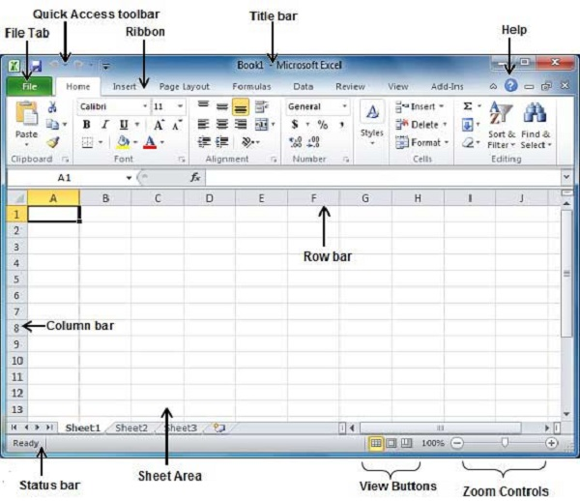

Slide 147
DATA AND SIZE OF DATA

Slide 148
What is Data?
Definition:
Data refers to raw facts and figures that can be processed to extract meaningful information. It can be qualitative (descriptive) or quantitative (numerical).
Characteristics:
Raw: Data is unprocessed and lacks context.
Varied: Data can come in various forms, including text, numbers, images, and sounds.
Dynamic: Data can change over time, reflecting new information or trends.
Examples:
Numbers (e.g., sales figures, temperatures)
Text (e.g., customer reviews, survey responses)
Images (e.g., photographs, diagrams)

Slide 149
Types of Data
Quantitative Data:
Definition: Numerical data that can be measured and expressed mathematically.
Examples: Height, weight, temperature, sales revenue.
Subtypes:
Discrete: Countable data (e.g., number of students).
Continuous: Measurable data (e.g., time, distance).
Qualitative Data:
Definition: Descriptive data that cannot be measured numerically but can be categorized.
Examples: Colors, names, opinions, and descriptions.
Subtypes:
Nominal: Categories without a specific order (e.g., gender, nationality).
Ordinal: Categories with a defined order (e.g., satisfaction ratings).

Slide 150
Importance of Data
Decision-Making:
Data-driven decisions lead to more accurate and effective outcomes in business, healthcare, education, and other fields.
Trend Analysis:
Analyzing data helps identify patterns and trends, enabling organizations to adapt strategies and improve performance.
Innovation:
Data fuels innovation by providing insights that can lead to new products, services, and processes.
Performance Measurement:
Organizations use data to measure performance against goals, assess efficiency, and identify areas for improvement.

Slide 151
Importance of Data Size
Why Data Size Matters:
Data size affects storage capacity, processing power, and transmission speed.
Large datasets can be cumbersome to manage, while small datasets may lack significance.
Understanding data size is crucial for efficient data handling and analysis.
Consequences of Ignoring Data Size:
Inadequate storage leading to data loss or corruption.
Slow processing times and decreased productivity.
Inefficient data transmission and increased costs.

Slide 152
Measurement Units of Data Size
Bits and Bytes:
Bit: The basic unit of information, represented by a 0 or 1.
Byte: A group of 8 bits, used to represent characters, numbers, or other data.
Kilobyte (KB), Megabyte (MB), Gigabyte (GB), and Terabyte (TB):
KB: 1,024 bytes (approximately 1,000 bytes).
MB: 1,024 kilobytes (approximately 1 million bytes).
GB: 1,024 megabytes (approximately 1 billion bytes).
TB: 1,024 gigabytes (approximately 1 trillion bytes).
Petabyte (PB), Exabyte (EB), and Zettabyte (ZB):
PB: 1,024 terabytes (approximately 1 quadrillion bytes).
EB: 1,024 petabytes (approximately 1 quintillion bytes).
ZB: 1,024 exabytes (approximately 1 sextillion bytes).

Slide 153
Small Data Size
Characteristics:
Small datasets are typically easy to manage and analyze.
They require minimal storage space and processing power.
Small datasets are often used for simple applications or proof-of-concepts.
Advantages:
Fast processing times and efficient analysis.
Low storage costs and minimal infrastructure requirements.
Easy to share and collaborate on small datasets.
Limitations:
Small datasets may lack statistical significance or representativeness.
They may not capture complex patterns or relationships.

Slide 154
Large Data Size
Characteristics:
Large datasets are often complex and require significant resources.
They can be difficult to manage, process, and analyze.
Large datasets are commonly used in big data analytics, machine learning, and data science.
Advantages:
Large datasets can provide statistically significant results and insights.
They can capture complex patterns and relationships.
Large datasets can be used for predictive modeling and forecasting.
Challenges:
High storage costs and infrastructure requirements.
Slow processing times and potential bottlenecks.
Difficulty in data quality control and data cleaning.

Slide 155
Implications of Data Size
Data Size and Analytics:
Large datasets require powerful analytics tools and techniques.
Small datasets may not require advanced analytics, but can still benefit from simple analysis.
Data Size and Storage:
Large datasets require significant storage capacity and infrastructure.
Small datasets can be stored on local devices or in the cloud.
Data Size and Collaboration:
Large datasets can be difficult to share and collaborate on due to size and complexity.
Small datasets are often easier to share and collaborate on.

Slide 156
No. | Abbreviation | Unit | Value | Size (in Bytes)
1 | b | Bit | 0 or 1 | 1/8 of a byte
2 | B | Byte | 8 bits | 1 byte
3 | KB | Kilobyte | 1,000 bytes | 1,000 bytes
4 | MB | Megabyte | 1,000² bytes | 1,000,000 bytes
5 | GB | Gigabyte | 1,000³ bytes | 1,000,000,000 bytes
6 | TB | Terabyte | 1,000⁴ bytes | 1,000,000,000,000 bytes
7 | PB | Petabyte | 1,000⁵ bytes | 1,000,000,000,000,000 bytes
8 | EB | Exabyte | 1,000⁶ bytes | 1,000,000,000,000,000,000 bytes
9 | ZB | Zettabyte | 1,000⁷ bytes | 1,000,000,000,000,000,000,000 bytes
10 | YB | Yottabyte | 1,000⁸ bytes | 1,000,000,000,000,000,000,000,000 bytes

Slide 157
YASSIFICATION
Yassification is the act of making something better, especially more visually appealing. Specifically, yassification is often used to refer to an internet meme in which pictures of people are edited using photo editing software or beauty filters to resemble an exaggerated, hyperfeminine version of a woman adhering to stereotypical beauty standards.
Yassification is a noun form of the verb yassify, which generally means to improve something, especially by making it more beautiful or glamorous.
The word yassification often refers to a meme or online trend in which a person edits a picture of a person to look extremely feminine with a large amount of makeup. The yassification meme often depicts classic paintings, photos of men, and pictures of unattractive fictional characters transformed into images of extremely feminine women that are often unrecognizable from the original.

Slide 158
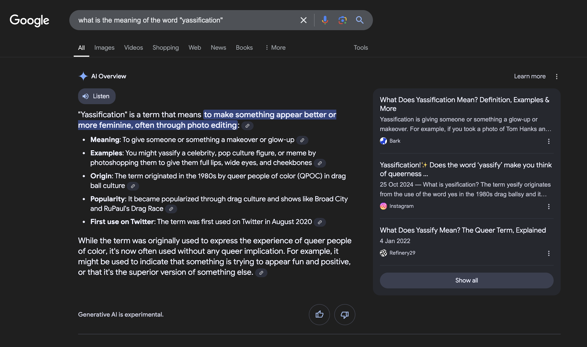

Slide 159
DEMURE
The term "demure" is an adjective that describes a person, typically a woman, who is reserved, modest, or shy in behavior or appearance. It often conveys a sense of propriety and decorum, suggesting that the individual is not overly forward or assertive.

Slide 160
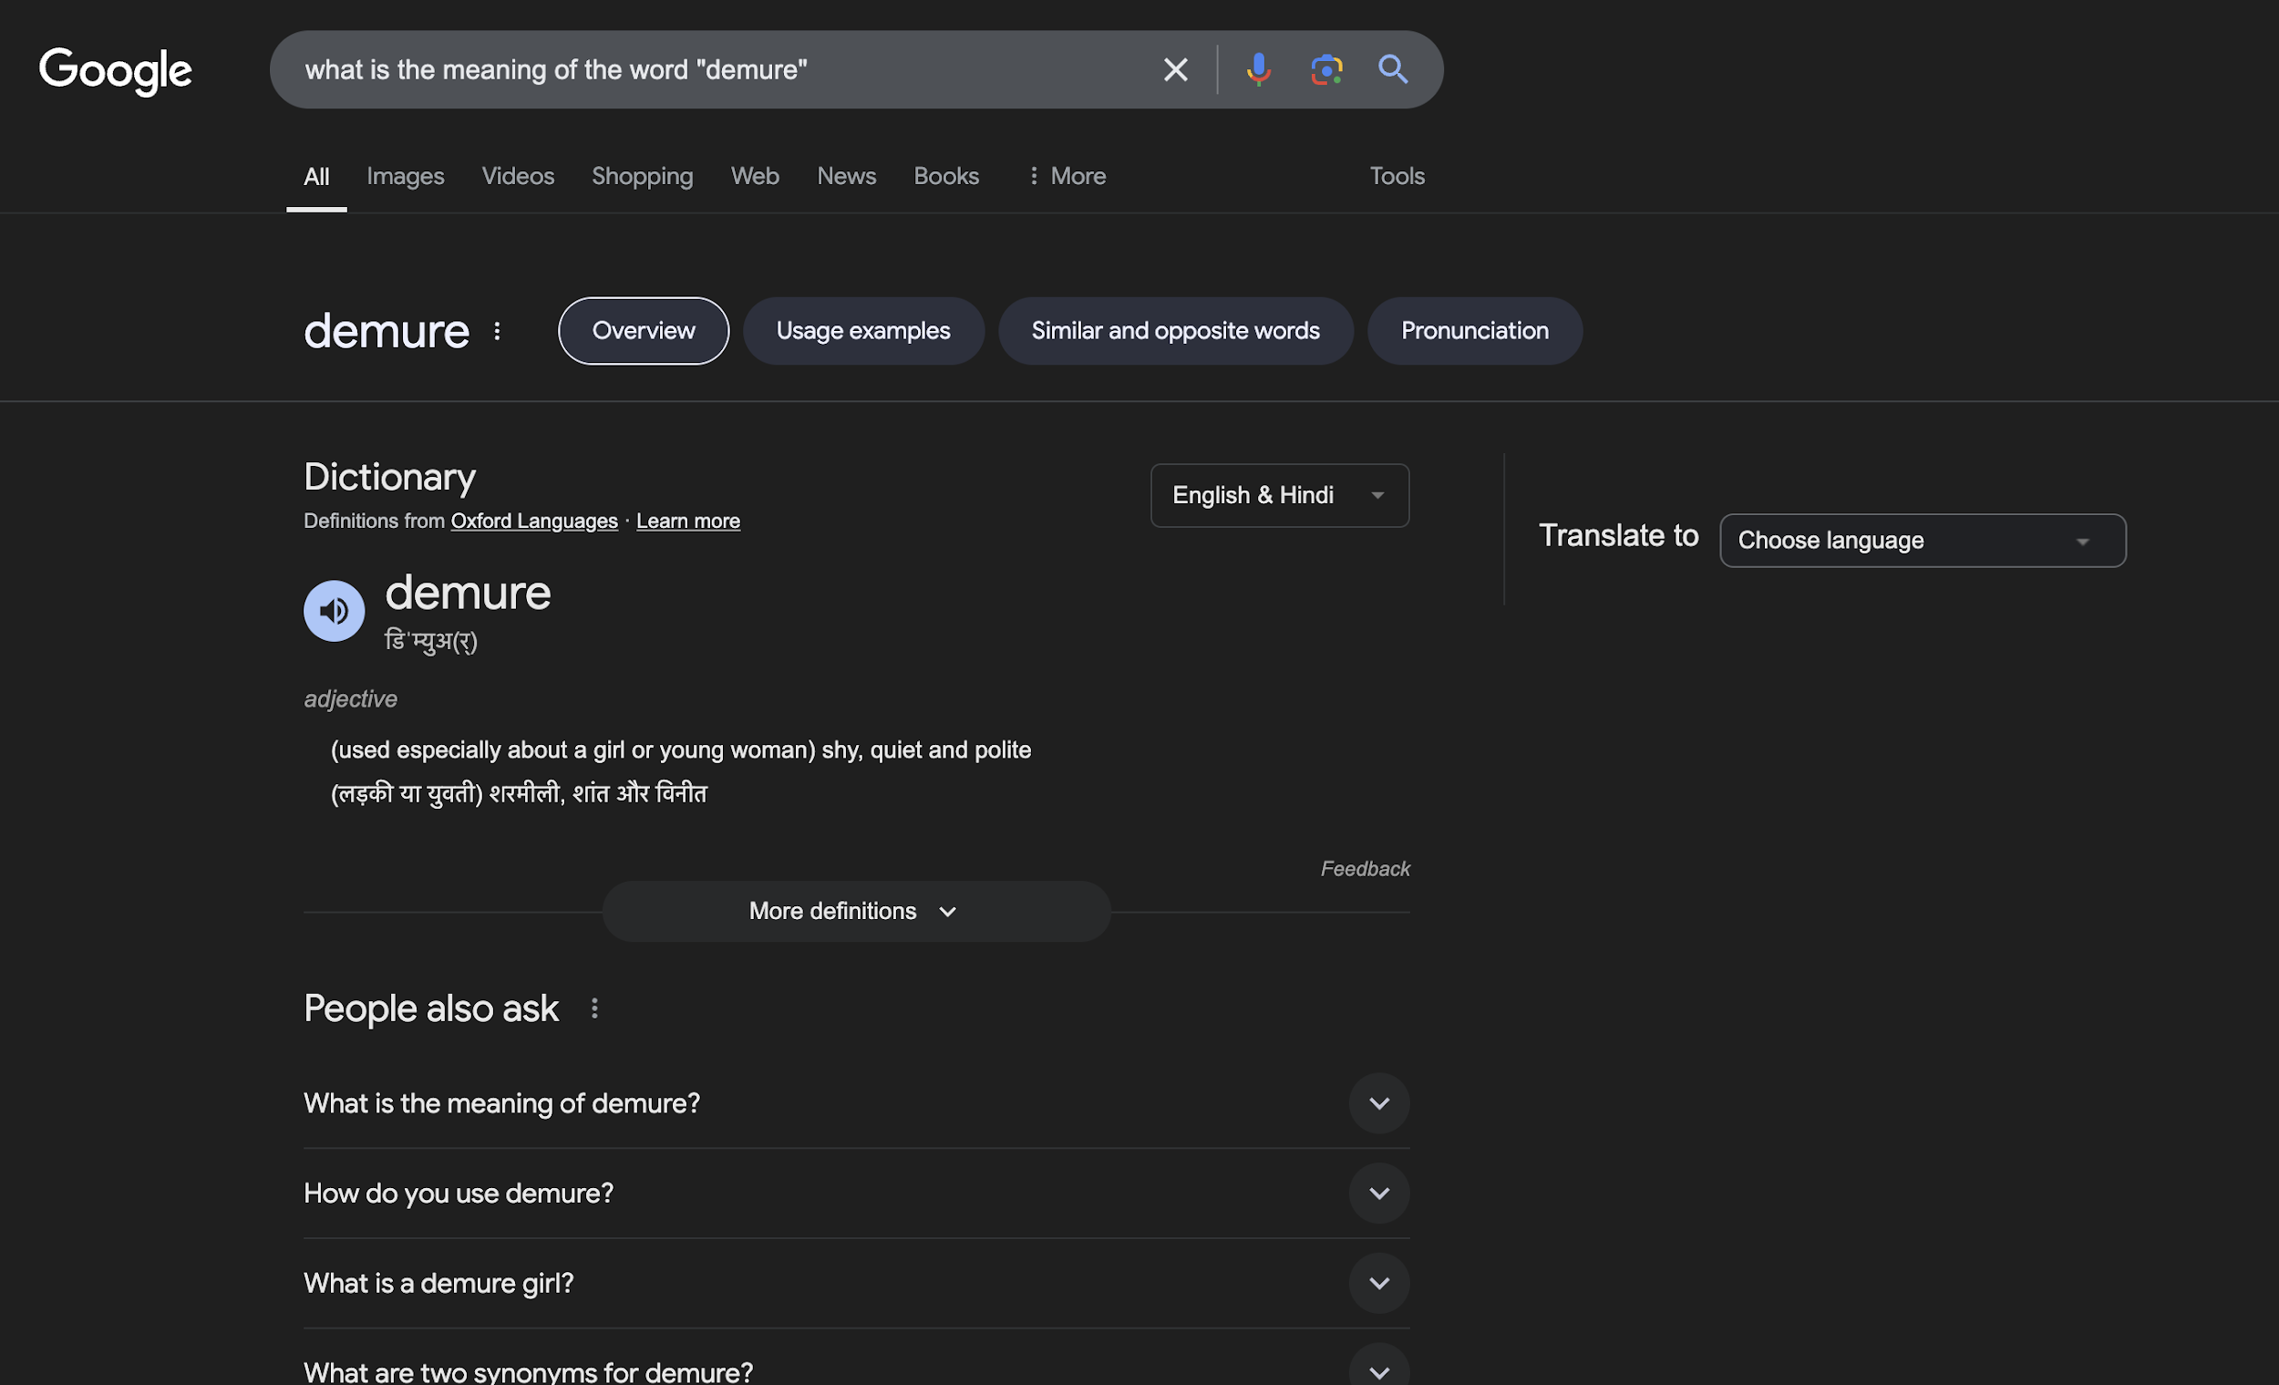

Slide 161
DELULU
The term "delulu" is a slang expression derived from the word "delusional." It is often used informally, particularly in online contexts, to describe someone who has unrealistic beliefs or perceptions, especially regarding relationships or situations.

Slide 162
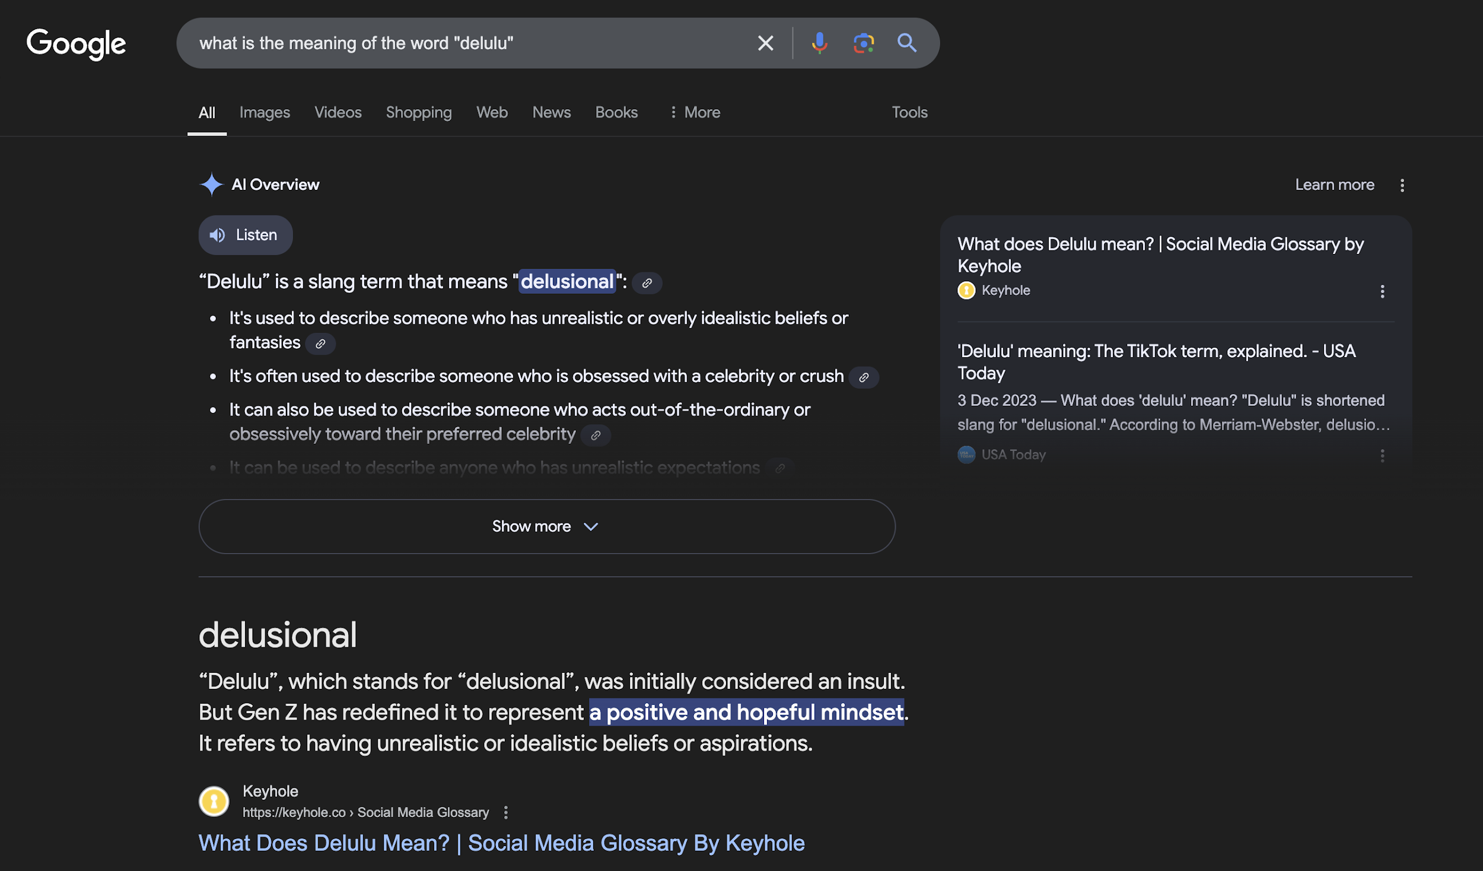

Slide 163
BRAINROT
Brainrot is a slang term used to describe a state of being obsessively fixated on something to the point where it consumes your thoughts. It often refers to being overly absorbed in a specific topic, media, or hobby, such as a TV show, book series, video game, or even a fictional character. The term suggests that this obsession "rots" your brain by dominating your mental space in an intense, often humorous or exaggerated, way.

Slide 164
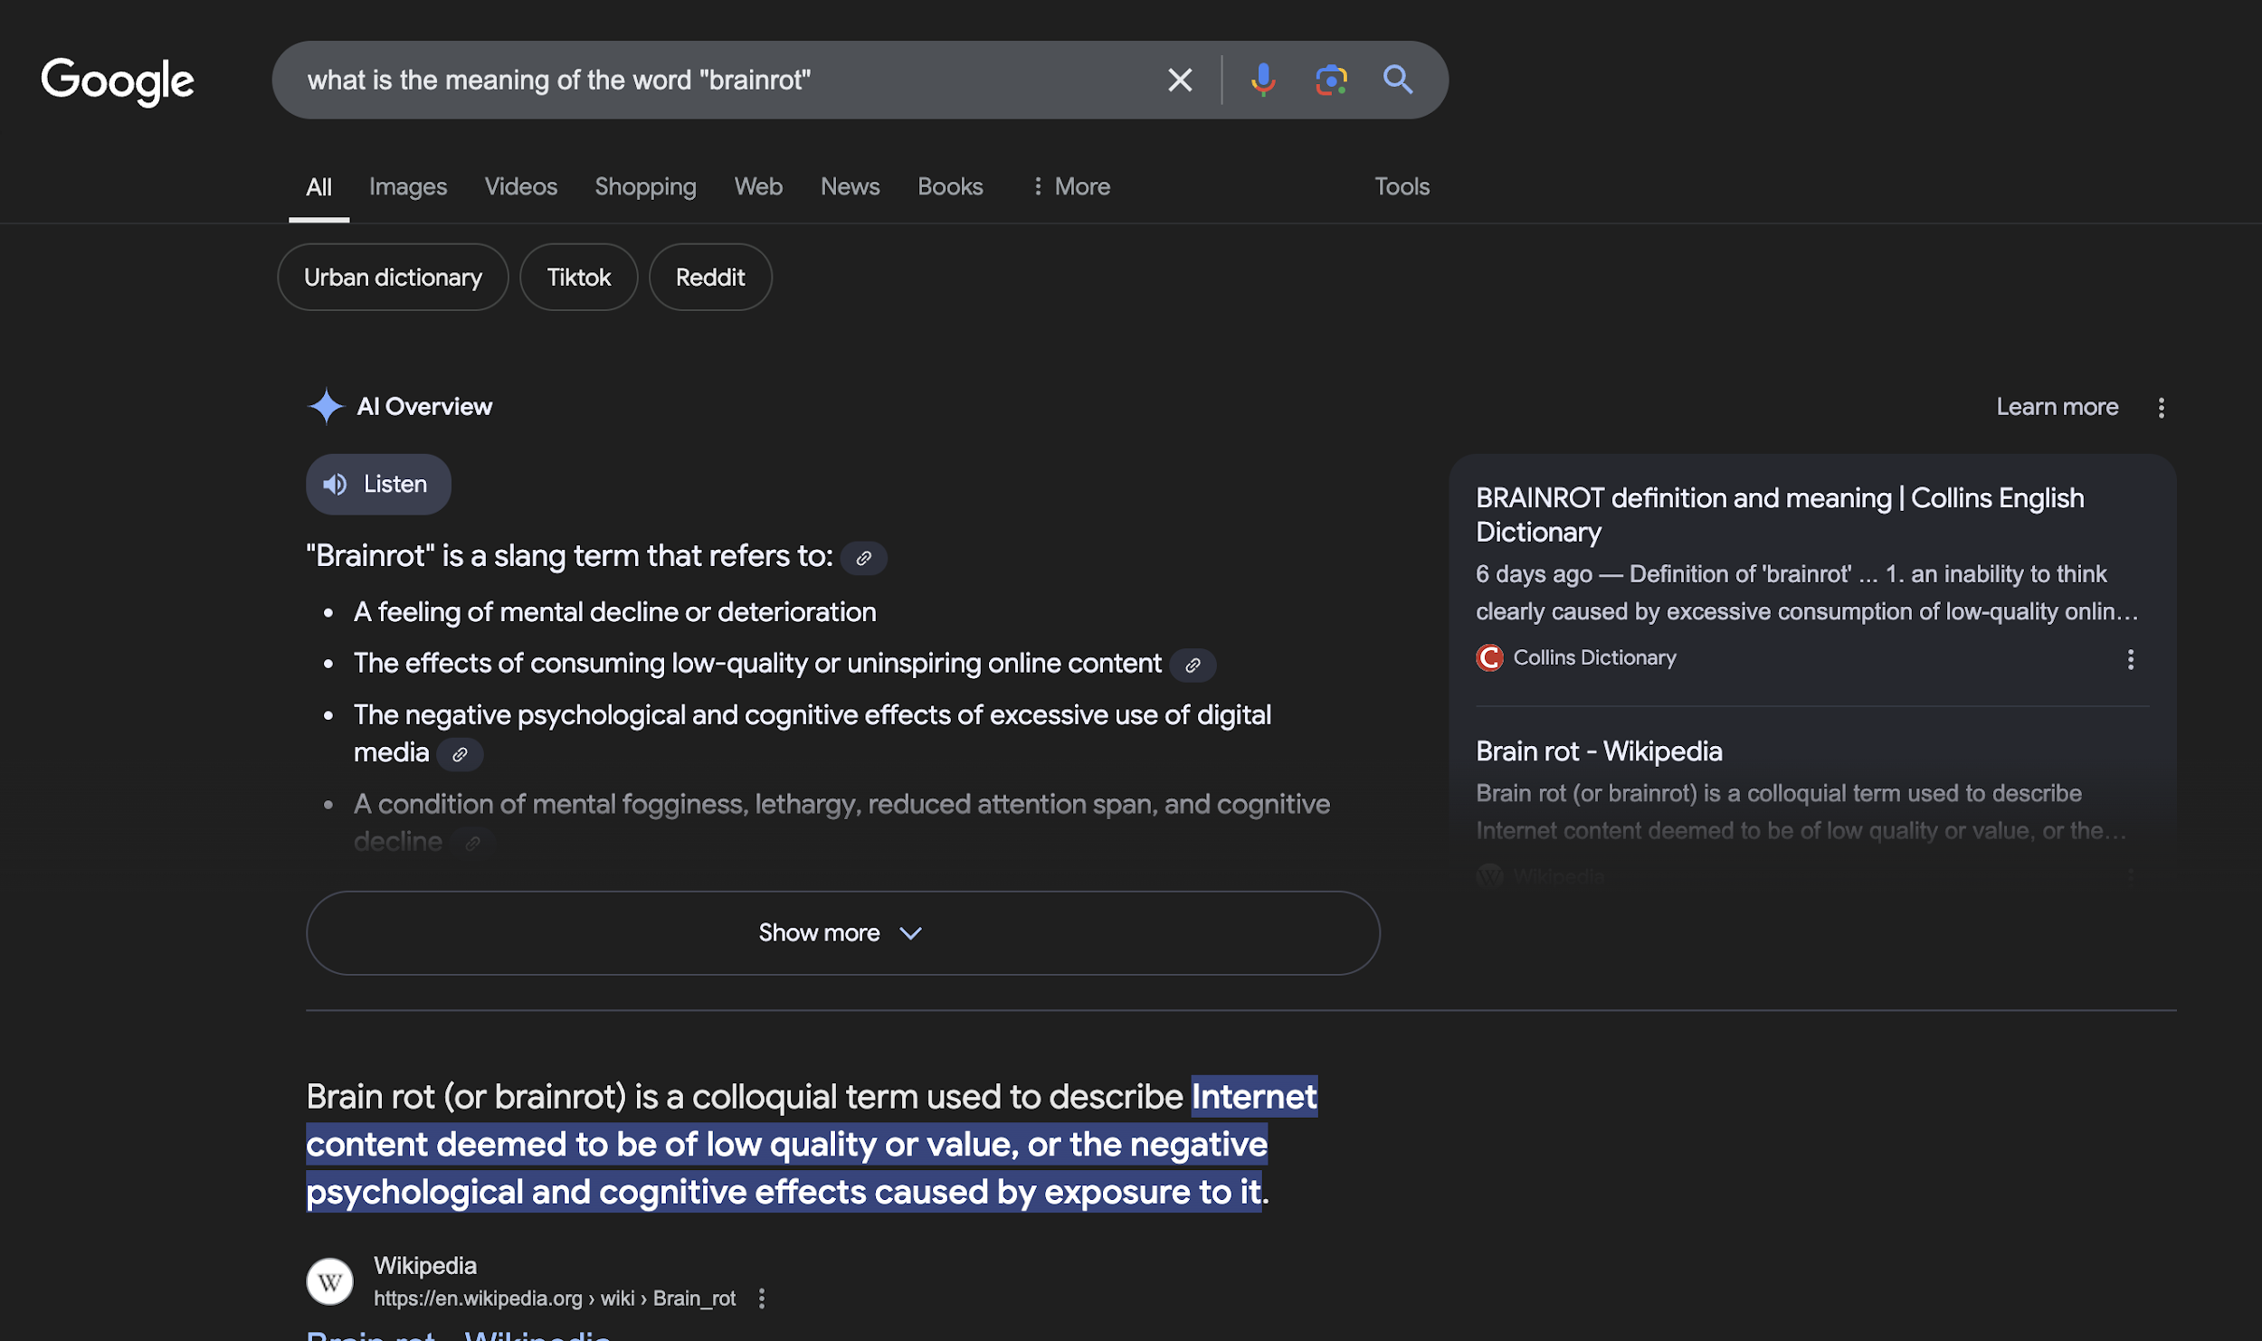

Slide 165
ENSHITTIFICATION
Enshittification is a slang term coined to describe the gradual decline in the quality and user experience of digital platforms, services, or systems as they prioritize profits over users. It often happens when a platform initially focuses on providing value to attract users, then shifts to monetization strategies that benefit advertisers, investors, or stakeholders at the expense of the user base.
This phenomenon can be seen in social media platforms, apps, or e-commerce sites where intrusive ads, exploitative algorithms, or excessive monetization reduce usability. Enshittification is driven by greed, loss of trust, and misaligned priorities.

Slide 166
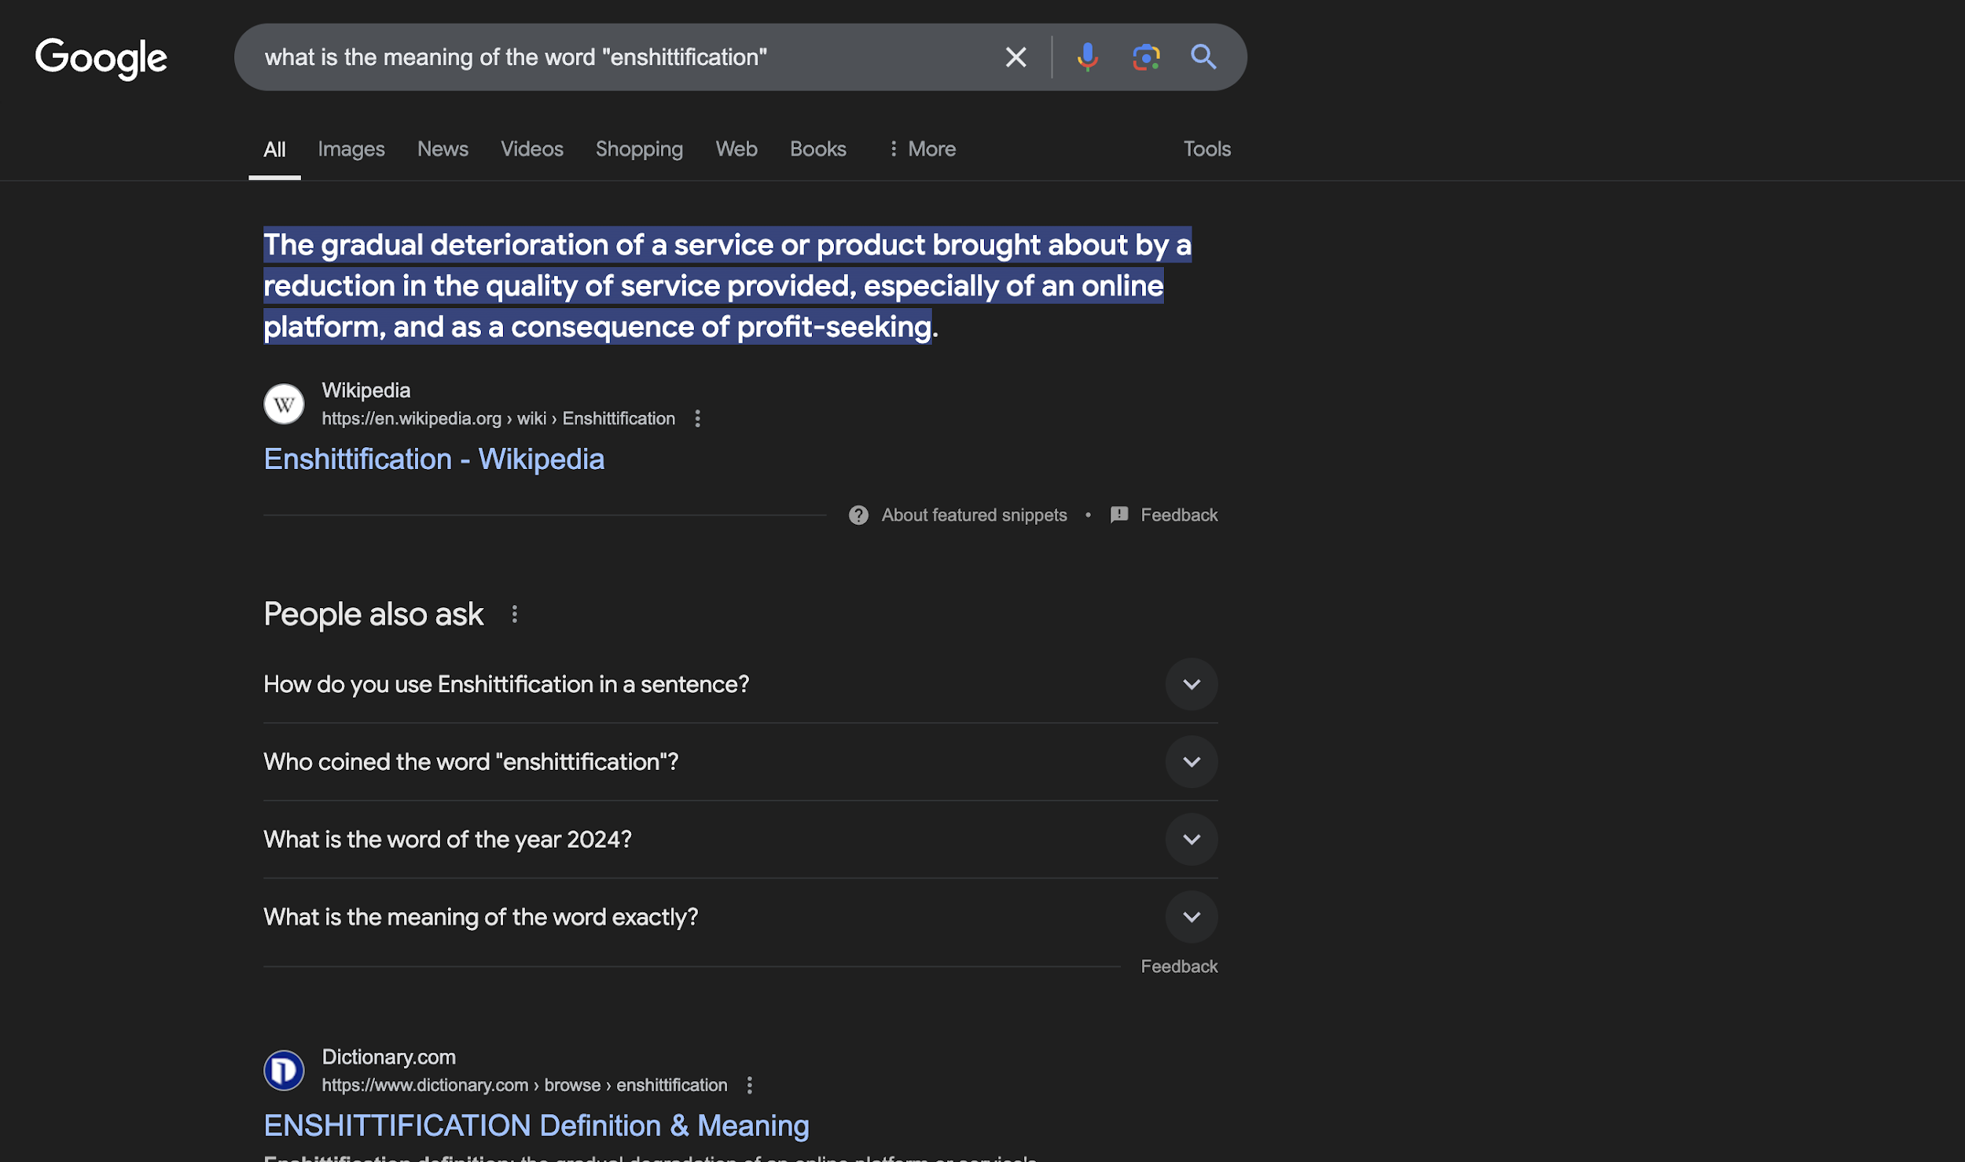

Slide 167
MANIFEST
The term "manifest" has several meanings, depending on the context in which it is used. Generally, it refers to the act of making something clear or evident. In a broader sense, it can mean to bring something into reality or to demonstrate a particular quality or feeling.
General Use: To manifest can mean to show or display something, such as emotions or intentions. For example, someone might manifest their happiness through smiles and laughter.
Psychological Context: In psychology and self-help, "manifesting" often refers to the practice of visualizing and attracting desired outcomes through positive thinking and intention-setting. This concept is popular in the law of attraction philosophy, where individuals believe that focusing on positive thoughts can bring about desired changes in their lives.

Slide 168
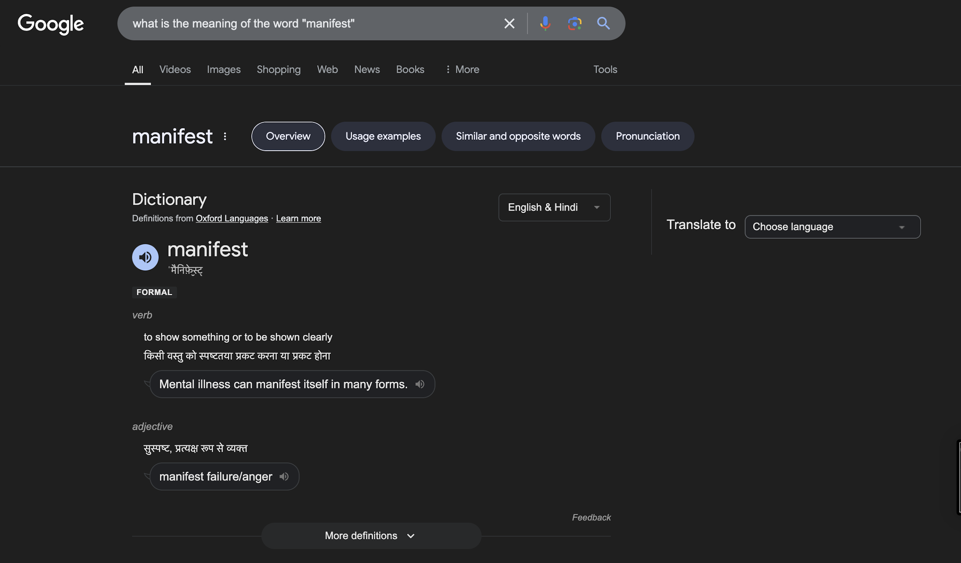

Slide 169
Inventory Management

Slide 170
Types of Inventory
Raw Materials: These are the basic inputs used in the manufacturing process. For example, steel for a car manufacturer or flour for a bakery. Managing raw materials effectively ensures that production can proceed without delays.
Work-in-Progress (WIP): This includes items that are in the process of being manufactured but are not yet finished. Effective management of WIP is crucial to minimize production bottlenecks and ensure a smooth workflow.
Finished Goods: These are products that have completed the manufacturing process and are ready for sale. Proper management of finished goods inventory helps meet customer demand promptly and reduces the risk of obsolescence.
Maintenance, Repair, and Operations (MRO): These supplies are necessary for the production process but do not become part of the final product. Examples include tools, cleaning supplies, and safety equipment. Managing MRO inventory ensures that production can continue without interruptions.

Slide 171
Key Inventory Management Techniques
Just-In-Time (JIT): This strategy aims to reduce inventory holding costs by receiving goods only as they are needed in the production process. JIT requires precise demand forecasting and strong supplier relationships to avoid stockouts.
ABC Analysis: This technique categorizes inventory into three classes based on their importance:
A items: High-value items with low sales frequency (e.g., expensive machinery).
B items: Moderate value and moderate sales frequency (e.g., mid-range tools).
C items: Low-value items with high sales frequency (e.g., screws and nails). This helps prioritize management efforts and resources.
Economic Order Quantity (EOQ): This formula calculates the optimal order quantity that minimizes total inventory costs, including ordering and holding costs. It helps businesses determine how much to order and when to order it.

Slide 172
Benefits of Effective Inventory Management
Cost Reduction: By optimizing inventory levels, businesses can lower storage costs, reduce waste from expired or obsolete products, and minimize capital tied up in unsold goods.
Improved Cash Flow: Efficient inventory management ensures that capital is not unnecessarily tied up in excess stock, allowing businesses to invest in other areas or respond to market opportunities.
Enhanced Customer Satisfaction: Maintaining optimal inventory levels ensures that products are available when customers want them, leading to higher satisfaction and repeat business.
Data-Driven Decisions: Effective inventory management systems provide valuable data that can inform demand forecasting, purchasing decisions, and overall business strategy.

Slide 173
Challenges in Inventory Management
Demand Fluctuations: Changes in customer preferences or market conditions can lead to unpredictable demand, resulting in either stockouts or excess inventory.
Supply Chain Disruptions: Events such as natural disasters, political instability, or supplier issues can disrupt the supply chain, affecting inventory levels and production schedules.
Inventory Accuracy: Maintaining accurate inventory records is essential for effective management. Discrepancies can lead to overstocking or stockouts, impacting customer satisfaction and profitability.
Obsolescence: Products can become outdated due to changes in technology or consumer preferences. Effective inventory management includes strategies to minimize the risk of holding obsolete stock.

Slide 174
Technology in Inventory Management
Inventory Management Software: These systems automate tracking, reporting, and analysis of inventory levels, improving accuracy and efficiency. They can provide real-time data and insights for better decision-making.
Barcode Scanning: Implementing barcode technology streamlines the stocktaking process, reduces human error, and speeds up order fulfillment. It allows for quick updates to inventory records.
Cloud-Based Solutions: These platforms enable real-time access to inventory data from anywhere, facilitating collaboration among teams and locations. They also allow for easier integration with other business systems.
Artificial Intelligence (AI): AI can analyze historical data to predict future demand trends, helping businesses optimize stock levels and reduce excess inventory. It can also automate reordering processes based on predictive analytics.

Slide 175
Best Practices for Inventory Management
Regular Audits: Conducting periodic inventory audits helps ensure that physical stock matches recorded inventory levels, identifying discrepancies and preventing losses.
Set Reorder Points: Establishing reorder points for each item helps ensure timely replenishment, preventing stockouts and maintaining service levels.
Train Staff: Providing training for employees on inventory management processes and systems ensures that everyone understands their roles and responsibilities, leading to more efficient operations.
Monitor KPIs: Key performance indicators (KPIs) such as inventory turnover ratio, carrying costs, and order accuracy should be regularly monitored to assess the effectiveness of inventory management practices and make necessary adjustments.

Slide 176
COLLABORATIVE BUDGETING

Slide 177
Definition and Importance of Collaborative Budgeting
Definition: Collaborative budgeting is a budgeting process that involves multiple stakeholders across various departments or teams within an organization. It emphasizes teamwork and communication to create a more accurate and comprehensive budget.
Importance:
Enhanced Accuracy: By involving various departments, organizations can gather diverse insights and data, leading to more accurate budget forecasts.
Increased Buy-In: When stakeholders participate in the budgeting process, they are more likely to support and adhere to the budget, as they feel a sense of ownership.
Improved Communication: Collaborative budgeting fosters open dialogue among departments, breaking down silos and encouraging a culture of transparency.

Slide 178
Key Features of Collaborative Budgeting
Cross-Functional Teams: Involves representatives from different departments (e.g., finance, marketing, operations) to ensure all perspectives are considered.
Iterative Process: The budgeting process is not a one-time event; it involves multiple rounds of discussions and revisions to refine the budget based on feedback and changing circumstances.
Use of Technology: Collaborative budgeting often leverages budgeting software and tools that facilitate real-time data sharing, communication, and tracking of budget changes.
Focus on Strategic Alignment: Ensures that departmental budgets align with the overall strategic goals of the organization, promoting coherence in resource allocation.

Slide 179
Benefits of Collaborative Budgeting
Greater Accountability: When teams are involved in the budgeting process, they are more accountable for their financial performance, leading to better resource management.
Enhanced Flexibility: Collaborative budgeting allows organizations to adapt to changes in the business environment more quickly, as teams can adjust their budgets based on real-time data and insights.
Improved Forecasting: By incorporating input from various departments, organizations can create more reliable forecasts that reflect actual business conditions and market trends.
Stronger Relationships: The collaborative process fosters stronger relationships among departments, promoting teamwork and cooperation that can extend beyond budgeting.

Slide 180
Challenges of Collaborative Budgeting
Time-Consuming: The inclusive nature of collaborative budgeting can make the process longer and more complex, requiring significant time and effort from all participants.
Potential for Conflict: Different departments may have competing priorities and interests, leading to disagreements that can complicate the budgeting process.
Data Overload: With input from multiple sources, organizations may face challenges in managing and synthesizing large amounts of data, making it difficult to reach consensus.
Need for Strong Leadership: Effective collaborative budgeting requires strong leadership to facilitate discussions, mediate conflicts, and ensure that the process stays on track.

Slide 181
Best Practices for Successful Collaborative Budgeting
Establish Clear Objectives: Define the goals of the budgeting process upfront to ensure all participants understand the purpose and desired outcomes.
Utilize Technology: Implement budgeting software that supports collaboration, allowing for real-time updates, data sharing, and communication among teams.
Encourage Open Communication: Foster an environment where team members feel comfortable sharing their insights and concerns, promoting transparency and trust.
Set a Realistic Timeline: Develop a timeline that allows for adequate discussion and revision while keeping the process efficient and focused.
Review and Adjust: After the budgeting process, conduct a review to assess what worked well and what could be improved for future budgeting cycles, ensuring continuous improvement.

Slide 182
FINANCIAL MODELING

Slide 183
Definition and Purpose of Financial Modeling
Definition: Financial modeling is the process of creating a numerical representation of a company’s financial performance, typically in the form of a spreadsheet. It involves forecasting future financial outcomes based on historical data and assumptions about future performance.
Purpose:
Decision-Making: Financial models help stakeholders make informed decisions regarding investments, budgeting, and strategic planning.
Valuation: Used to assess the value of a business or project, aiding in mergers and acquisitions, fundraising, and investment analysis.
Scenario Analysis: Allows users to evaluate the impact of different scenarios (e.g., best-case, worst-case) on financial performance, helping to identify risks and opportunities.

Slide 184
Key Components of Financial Models
Assumptions: The foundation of any financial model, assumptions include growth rates, cost structures, and market conditions. These should be realistic and based on historical data and market research.
Income Statement: Projects revenues, expenses, and profits over a specific period. It provides insights into the company’s profitability and operational efficiency.
Cash Flow Statement: Forecasts cash inflows and outflows, highlighting the company’s liquidity position. It is crucial for understanding how well the company can meet its short-term obligations.
Balance Sheet: Projects the company’s assets, liabilities, and equity at a specific point in time. It provides a snapshot of the company’s financial health and capital structure.
Supporting Schedules: Detailed calculations that support the main financial statements, such as revenue breakdown, depreciation schedules, and working capital analysis.

Slide 185
Types of Financial Models
Three-Statement Model: Integrates the income statement, cash flow statement, and balance sheet into a cohesive model. It is the foundation for most financial analysis.
Discounted Cash Flow (DCF) Model: Estimates the value of an investment based on its expected future cash flows, discounted back to their present value. It is widely used for valuation purposes.
Leveraged Buyout (LBO) Model: Used to evaluate the financial feasibility of acquiring a company using a significant amount of debt. It focuses on cash flow generation and debt repayment.
Merger and Acquisition (M&A) Model: Analyzes the financial implications of merging with or acquiring another company, including synergies, valuation, and impact on earnings.
Budget Model: Helps organizations plan and allocate resources by forecasting revenues and expenses over a specific period, often used for annual budgeting

Slide 186
Best Practices in Financial Modeling
Keep It Simple: A clear and straightforward model is easier to understand and maintain. Avoid unnecessary complexity that can lead to errors.
Use Consistent Formatting: Standardize the layout, color coding, and labeling throughout the model to enhance readability and usability.
Document Assumptions: Clearly outline and justify all assumptions used in the model. This transparency helps users understand the basis for projections and facilitates future updates.
Test for Errors: Regularly check the model for errors and inconsistencies. Use built-in Excel tools like auditing functions to identify and correct mistakes.
Scenario and Sensitivity Analysis: Incorporate features that allow users to test different scenarios and assess how changes in key assumptions impact financial outcomes.

Slide 187
Applications of Financial Modeling
Investment Analysis: Investors use financial models to evaluate potential investments, assess risk, and determine expected returns.
Corporate Finance: Companies utilize financial models for budgeting, forecasting, and strategic planning, helping to allocate resources effectively.
Valuation: Financial models are essential for valuing businesses in M&A transactions, IPOs, and other investment opportunities.
Performance Monitoring: Organizations can use financial models to track actual performance against forecasts, enabling timely adjustments to strategies and operations.
Risk Management: By modeling various scenarios, companies can identify potential risks and develop strategies to mitigate them, ensuring better preparedness for uncertainties.

Slide 188
BOOKING SYSTEM

Slide 189
Definition and Purpose of a Booking System
Definition: A booking system is a software application that allows users to reserve services, accommodations, or resources online. It automates the process of scheduling and managing bookings for businesses such as hotels, airlines, restaurants, and event venues.
Purpose:
Streamline Operations: Automates the booking process, reducing manual work and minimizing errors.
Enhance Customer Experience: Provides a user-friendly interface for customers to easily make reservations, check availability, and receive confirmations.
Increase Revenue: Optimizes resource allocation and maximizes occupancy or utilization rates, leading to higher revenue generation.

Slide 190
Key Features of a Booking System
Real-Time Availability: Displays up-to-date availability of services or resources, allowing customers to see what is open for booking at any given time.
User -Friendly Interface: Intuitive design that simplifies the booking process for users, including easy navigation, search functionality, and clear instructions.
Payment Processing: Secure payment gateways that allow customers to make payments online, including options for credit cards, digital wallets, and other payment methods.
Automated Notifications: Sends automated email or SMS confirmations, reminders, and updates to customers regarding their bookings, enhancing communication.
Reporting and Analytics: Provides insights into booking trends, customer preferences, and financial performance, helping businesses make informed decisions.

Slide 191
Types of Booking Systems
Hotel Booking Systems: Designed for hotels and accommodations, allowing guests to book rooms, check availability, and manage reservations.
Event Booking Systems: Used for managing ticket sales and reservations for events such as concerts, conferences, and workshops, often including seating arrangements.
Travel Booking Systems: Facilitates the booking of flights, car rentals, and travel packages, integrating various travel services into a single platform.
Restaurant Reservation Systems: Allows customers to book tables at restaurants, manage reservations, and optimize seating arrangements.
Appointment Scheduling Systems: Used by service-based businesses (e.g., salons, clinics) to manage appointments, allowing customers to book services at their convenience.

Slide 192
Benefits of Implementing a Booking System
Increased Efficiency: Reduces the time spent on manual booking processes, allowing staff to focus on customer service and other critical tasks.
24/7 Availability: Enables customers to make bookings at any time, increasing convenience and potentially leading to more sales.
Reduced No-Shows: Automated reminders and confirmations help decrease the likelihood of no-shows, improving overall resource utilization.
Enhanced Customer Insights: Collects data on customer preferences and behaviors, enabling businesses to tailor their offerings and marketing strategies.
Scalability: A robust booking system can grow with the business, accommodating increased bookings and additional services without significant changes to the infrastructure.

Slide 193
Challenges in Booking Systems
Technical Issues: System downtime or bugs can disrupt the booking process, leading to customer frustration and potential loss of revenue.
Data Security: Protecting sensitive customer information, such as payment details, is critical. Businesses must ensure compliance with data protection regulations.
Integration with Other Systems: Ensuring that the booking system integrates seamlessly with other business systems (e.g., CRM, accounting software) can be complex.
User Adoption: Employees and customers may resist transitioning to a new system, requiring training and support to ensure smooth adoption.
Customization Needs: Different businesses have unique requirements, and finding a booking system that can be tailored to specific needs can be challenging

Slide 194
Best Practices for Implementing a Booking System
Define Clear Objectives: Establish what you want to achieve with the booking system, such as improving efficiency, increasing sales, or enhancing customer experience.
Choose the Right Software: Evaluate different booking systems based on features, scalability, user-friendliness, and integration capabilities to find the best fit for your business.
Provide Training: Ensure that staff are adequately trained on how to use the system, including troubleshooting common issues and understanding customer interactions.
Gather Customer Feedback: Regularly solicit feedback from customers regarding their booking experience to identify areas for improvement.
Monitor Performance: Continuously track key performance indicators (KPIs) related to bookings, customer satisfaction, and revenue to assess the effectiveness of the system and make necessary adjustments.

Slide 195
CRM SYSTEM

Slide 196
Definition and Purpose of a CRM System
Definition: A Customer Relationship Management (CRM) system is a software solution that helps businesses manage interactions with current and potential customers. It centralizes customer data, streamlines processes, and enhances communication.
Purpose:
Centralize Customer Information: Stores all customer-related data in one place, making it easily accessible to all relevant stakeholders.
Enhance Customer Relationships: Facilitates better communication and engagement with customers, leading to improved satisfaction and loyalty.
Drive Sales Growth: Provides tools for tracking sales activities, managing leads, and analyzing customer behavior to optimize sales strategie

Slide 197
Key Features of a CRM System
Contact Management: Organizes and manages customer information, including contact details, communication history, and preferences.
Sales Automation: Automates repetitive sales tasks, such as lead tracking, follow-ups, and reporting, allowing sales teams to focus on closing deals.
Marketing Automation: Enables targeted marketing campaigns through segmentation, email marketing, and tracking customer interactions with marketing materials.
Customer Support Management: Provides tools for managing customer inquiries, support tickets, and service requests, ensuring timely and effective responses.
Analytics and Reporting: Offers insights into customer behavior, sales performance, and marketing effectiveness through customizable reports and dashboards.

Slide 198
Types of CRM Systems
Operational CRM: Focuses on automating and improving customer-facing processes, including sales, marketing, and customer service. It enhances efficiency and streamlines workflows.
Analytical CRM: Concentrates on analyzing customer data to gain insights into customer behavior, preferences, and trends. It helps businesses make data-driven decisions.
Collaborative CRM: Facilitates communication and collaboration among different departments (e.g., sales, marketing, support) to provide a unified customer experience.
Strategic CRM: Aligns customer relationship strategies with business goals, focusing on long-term customer engagement and value creation.
Social CRM: Integrates social media channels into the CRM system, allowing businesses to engage with customers on platforms like Facebook, Twitter, and LinkedIn.

Slide 199
Benefits of Implementing a CRM System
Improved Customer Relationships: By having access to comprehensive customer data, businesses can personalize interactions and respond more effectively to customer needs.
Increased Sales Efficiency: Automating sales processes and tracking leads helps sales teams prioritize their efforts and close deals more effectively.
Enhanced Collaboration: A centralized system allows different departments to share information and collaborate on customer interactions, leading to a more cohesive approach.
Better Data Management: CRM systems provide a structured way to collect, store, and analyze customer data, improving data accuracy and accessibility.
Informed Decision-Making: Analytics and reporting features enable businesses to make data-driven decisions, optimizing marketing strategies and resource allocation.

Slide 200
Challenges in CRM Implementation
User Adoption: Employees may resist using a new system, requiring training and change management strategies to encourage adoption.
Data Quality: Inaccurate or incomplete data can undermine the effectiveness of a CRM system. Regular data cleansing and validation are necessary.
Integration Issues: Integrating the CRM system with existing software and tools (e.g., ERP, marketing platforms) can be complex and time-consuming.
Cost of Implementation: The initial investment in a CRM system, including software, training, and ongoing maintenance, can be significant.
Customization Needs: Different businesses have unique requirements, and finding a CRM solution that can be tailored to specific needs can be challenging.

Slide 201
Best Practices for Successful CRM Implementation
Define Clear Objectives: Establish specific goals for what you want to achieve with the CRM system, such as improving customer retention or increasing sales.
Involve Stakeholders: Engage key stakeholders from different departments in the selection and implementation process to ensure the system meets diverse needs.
Provide Comprehensive Training: Offer training sessions and resources to help employees understand how to use the CRM system effectively.
Regularly Review and Update Data: Implement processes for maintaining data quality, including regular audits and updates to customer information.
Monitor Performance and Gather Feedback: Continuously assess the effectiveness of the CRM system through performance metrics and user feedback, making adjustments as needed to optimize its use.

Slide 202


